Slide 1
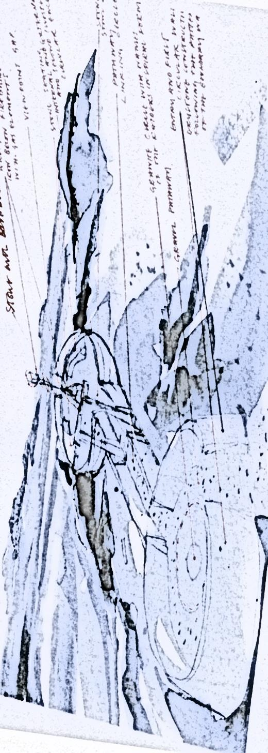
AN SUILEACHAN
A monument to remember the Land Clearances, to commemorate the Reef Raiders and to celebrate the formation of the Bhaltos Community Trust

Slide 2
FUNDING PARTNERS
Many thanks to our funding partners -
CAPITAL ARTS REGENERATION FUND
SCOTLANDS ISLANDS
PROISEACT NAN EALAN
UIG COMMUNITY COUNCIL
BHALTOS COMMUNITY TRUST

Slide 3



Slide 4



Slide 5
THE BHALTOS COMMUNITY TRUST
The Bhaltos Community Trust was set up in 1998. It currently has 105 members. Its aims are as follows:
To acquire and manage the lands and resources comprising the crofting estate of Bhaltos for the benefit of the whole community of the estate.
To promote and assist the utilisation of the resources of the Bhaltos crofting estate and the creation of sustainable development therein, beneficial to the whole community.
To improve the social, economic, educational and cultural environment of the Bhaltos Trust Community.
To conserve and improve the natural environment of the Bhaltos Estate.
To preserve as far as possible all items of archaeological interest on the Bhaltos Estate and to encourage archaeological study and exploration on the estate.

Slide 6
THE PROJECT
It was agreed at a public meeting of the Bhaltos Community Trust that a
suitable commemorative landmark work of public art be commissioned to mark the following:
To remember the 19th century Lewis Land Clearances
To commemorate the 20th century land raids by the Reef Raiders
To celebrate the Scottish Land Reforms and the creation of the Bhaltos Community Trust
The commissioned design was to be constructed on an elevated, panoramic site in the village of Reef, with views over the surrounding land, sea and islands.

Slide 7
THE DESIGN TEAM
Will Maclean and Marian Leven were asked to design a suitable piece of public art based on their understanding of the local culture and history of the land raids in the Western Isles. They have in the past, along with Jim Crawford who is a well known local historian and stone-worker, created landmark sculptures and monuments at the following places:
Nan Gaisgaich Memorial Cairn in 1994 to commemorate the Deer Park Raiders of 1887
Aignish Memorial Sculpture in 1996 to commemorate the Land Uprisings of 1888.
Cuimhneachain Nan Gaisgeach at Gress River to commemorate the land raids of 1915
Craunghael at Sabhal Mor Ostaig
Cairngorm Viewpoint

Slide 8
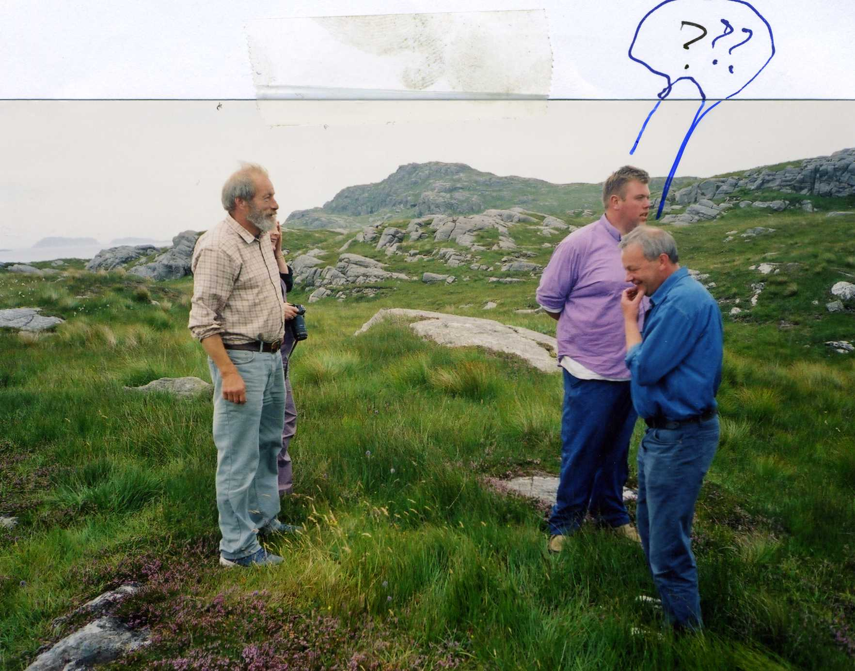
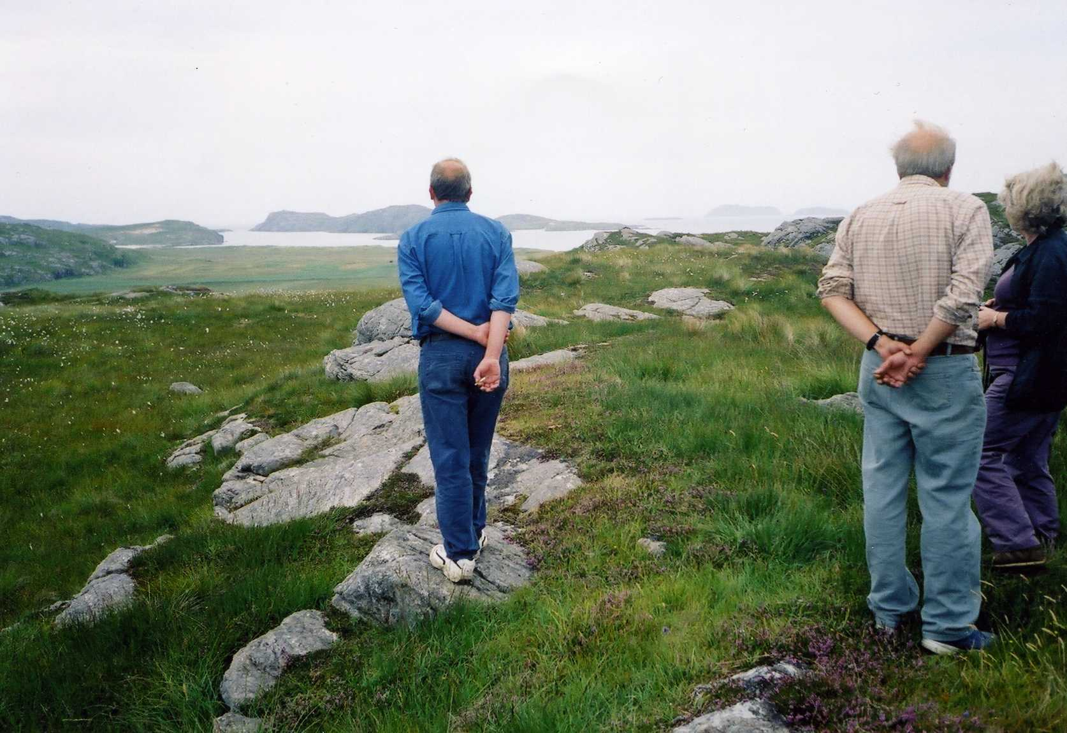
The first step was to find a good site. Which area within the Bhaltos Peninsula would fit the bill?
Will, Marian, Sandy, Finn and Norry consider the options.

Slide 9
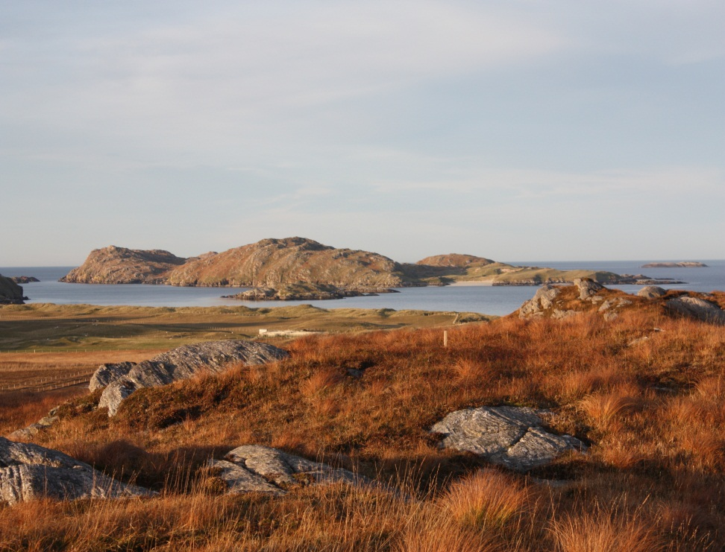
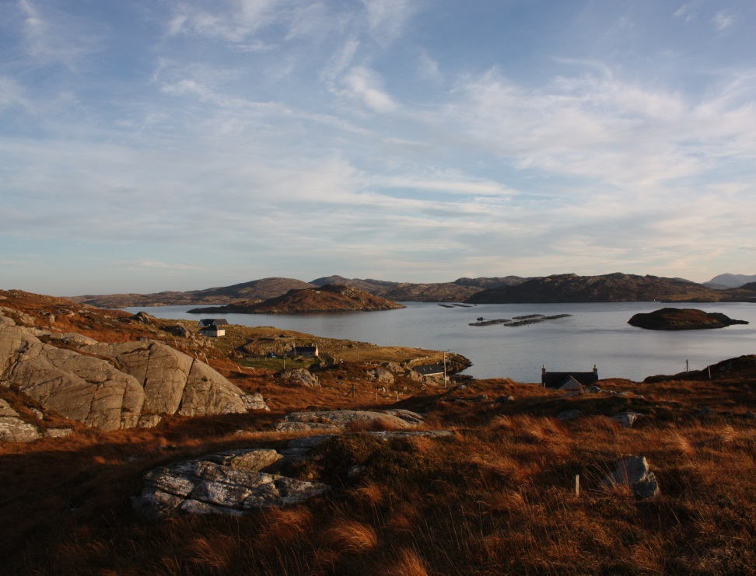
An appropriate site was selected. An Sùileachan is situated on a panoramic site overlooking Pabbay and also overlooking West Loch Roag.

Slide 10
THE WORKFORCE
DESIGNERS WILL MACLEAN
MARIAN LEVEN
STONE CIRCLES IAN SMITH
ARCHWAY JIM CRAWFORD
BLACKSMITH JOHN MACLEOD
WOODWORK JOHN ANGUS MACLEOD
GROUNDWORK D J MACDONALD
PLANNING APPLICATION JOHN NORGROVE
INFORMATION BOARD RHONA MERRIT, JONI BUCHANAN
ANNA MACKINNON
PROJECT MANAGER NORRY MACKAY
ADMINISTRATOR DONELLA MACDONALD
PHOTOGRAPHER COLIN MACDONALD
With help and advice from Finn, Sandy, Ian George, and many others who gave freely of their personal time to help with different aspects of the project.

Slide 11
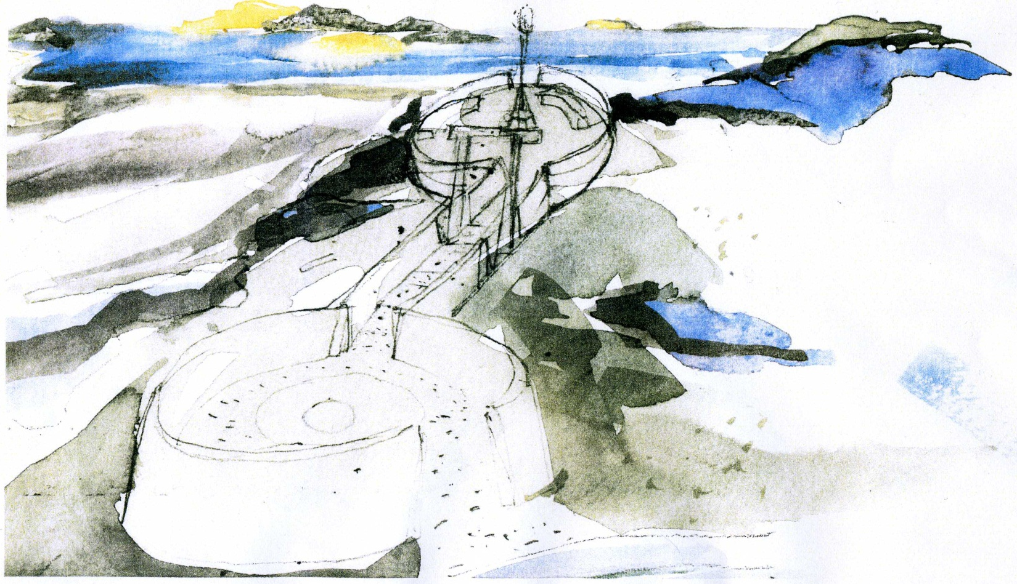
AN ARTISTIC IMPRESSION OF AN SUILEACHAN

Slide 12
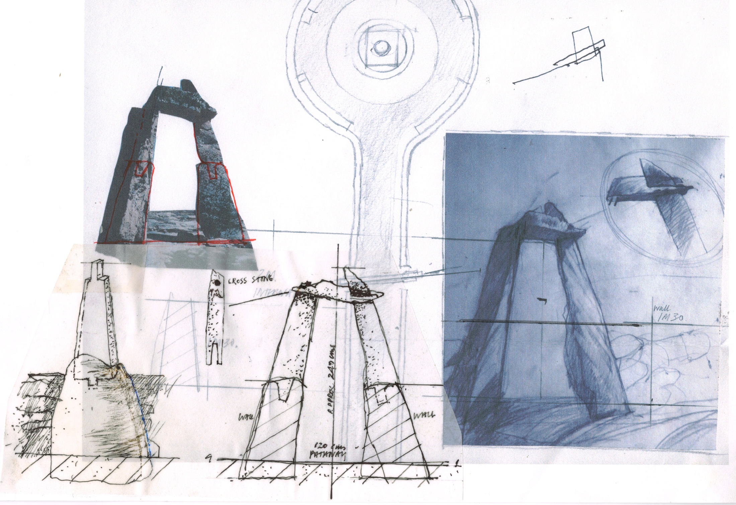

Slide 13
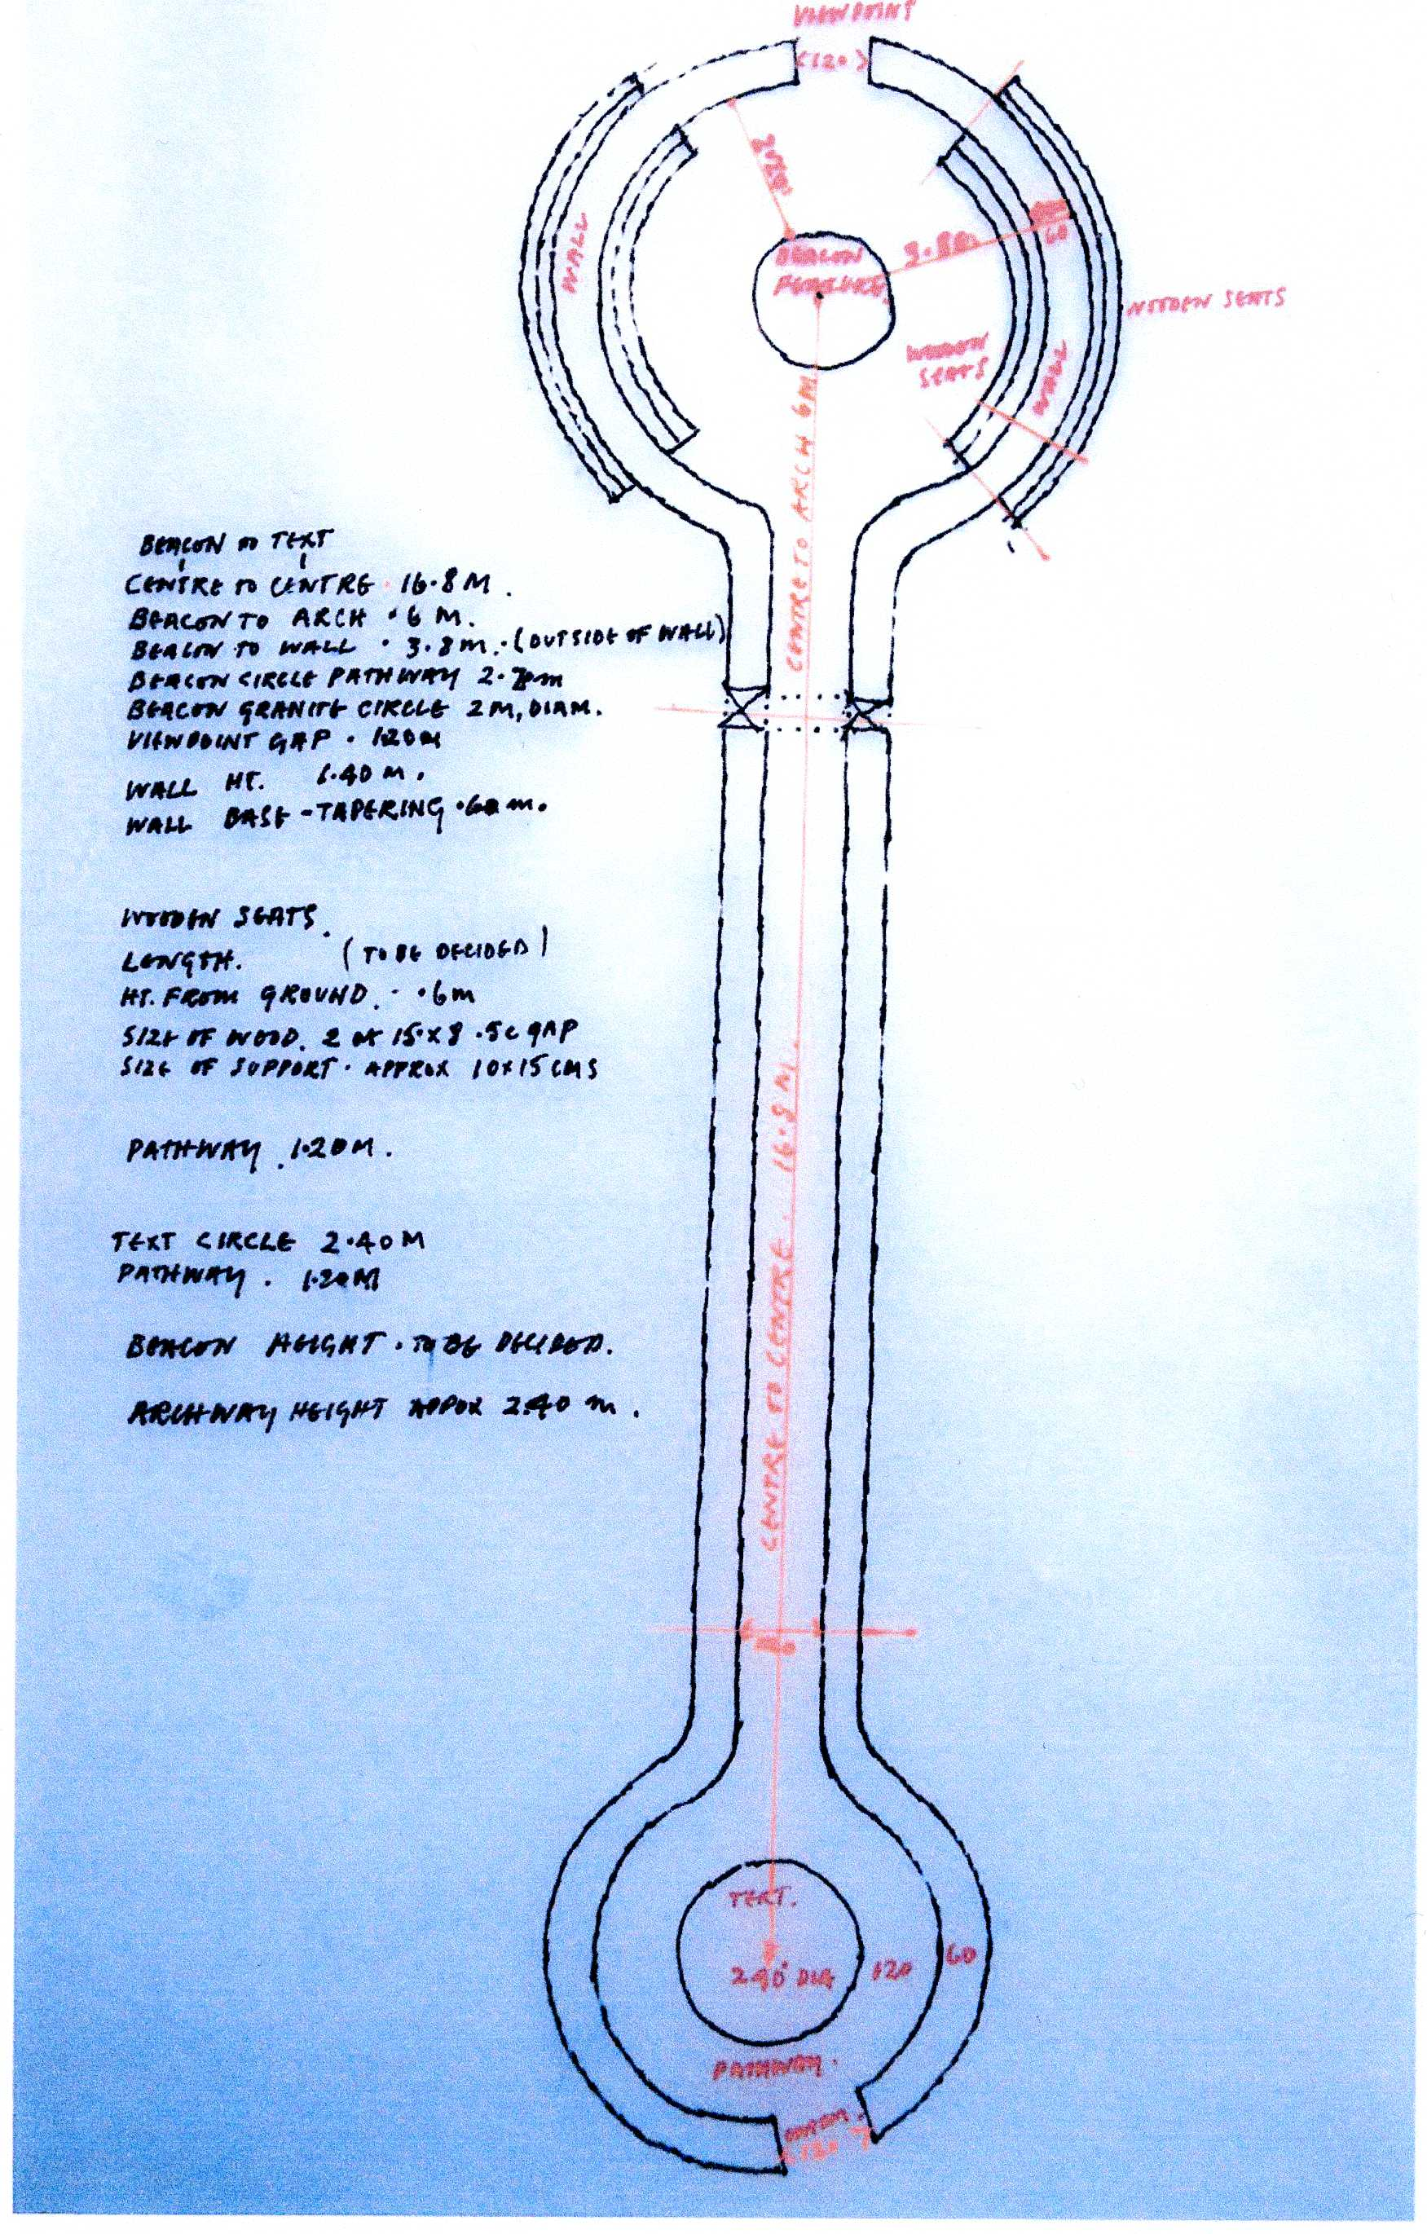

Slide 14
AnSùileachan
This orbits around the word sùil – the Gaelic for eye, but which extrapolates out to ‘eye-opener’ and ‘noteworthy’ and even ‘prescient’ and ‘far-seeing’.
It looks as much to the future as to the past.
Many thanks to Dr Finlay Macleod who created this name for the project

Slide 15
THE DESIGN
The structure was designed to sit on a panoramic site overlooking the surrounding land, sea and islands. It has two stone circles, connected by a walled walkway with one of the circles containing a circle engraved with the names of the Reef Raiders. The walkway leads the visitor through a stone archway to the other circle, which houses a millstone upon which is mounted an iron beacon, with wooden seating both inside and outside the circle.
An Sùileachan was created to celebrate island craftsmanship and skills. The land around Bhaltos is defined by old stone walls skilfully built and of a distinctive style. This is replicated in the walls which are constructed from stones sourced from old buildings in the Uig area.
The iron basket was made from old graveyard railings from one of the Stornoway cemeteries and crafted by our Stornoway blacksmith.
The seating at the monument was constructed from windblown timber from the Stornoway Trust and made by John Angus Macleod of Reef.

Slide 16
An Sùileachan has been built on a panoramic site which overlooks an ancient landscape of wheelhouses and brochs, Norse mills and island duns. There are Viking burial sites and evidence of community life predating the Callanish Standing Stones .
There are the remains of blackhouses - cleared communities who were forced to move from this area and there are the stories of the Land Raiders, who along with crofters in many other communities, decided to stand up against injustice and poverty and fight for the right to their own land.
We live in a culturally rich community and An Sùileachan has been created to celebrate the different facets of this evolution, from the distant past of Viking settlements, to the land clearances and the land raids and onward to the Scottish Land Reforms which gave us the right to determine our own future through community land ownership.

Slide 17
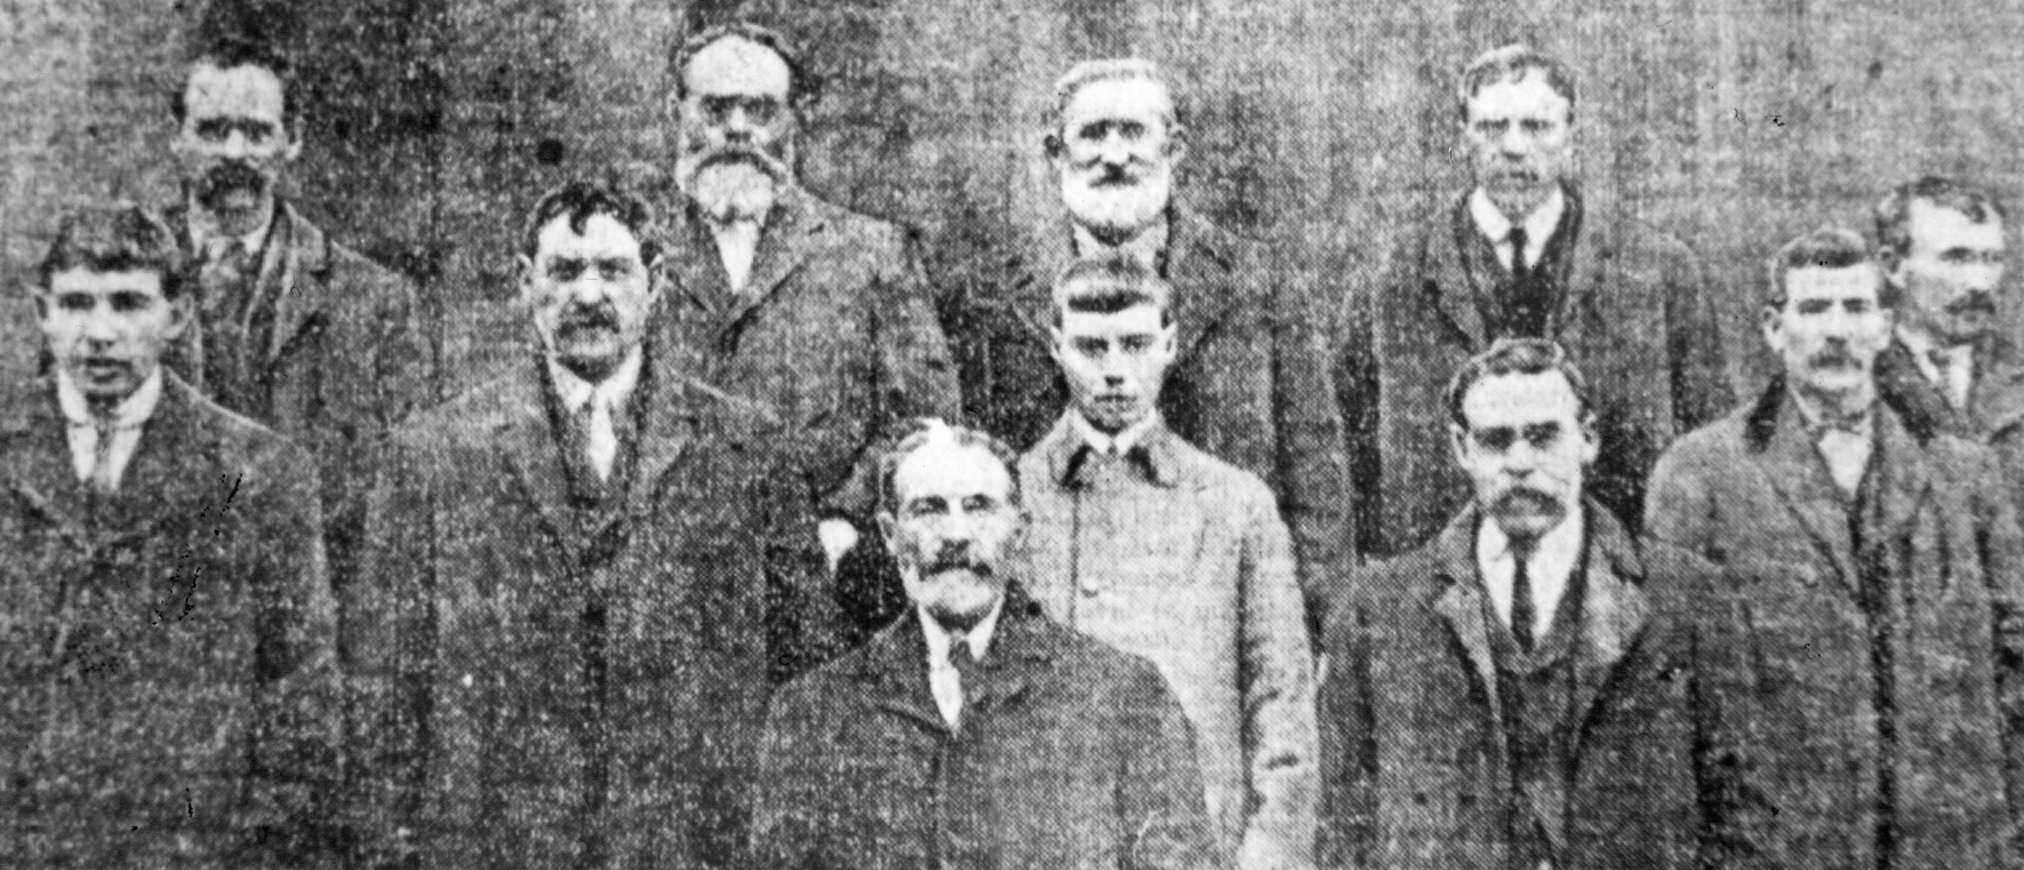
THE REEF RAIDERS
This is a photograph of the Reef Raiders who were arrested for raiding Reef Farm. Their story is documented on the information board and their names appear on the stone circle.
Joni Buchanan, Rhona Meritt , Anna Mackinnon and Teen Anne Murray collaborated on the historical context, the bi-lingual design and narrative.

Slide 18
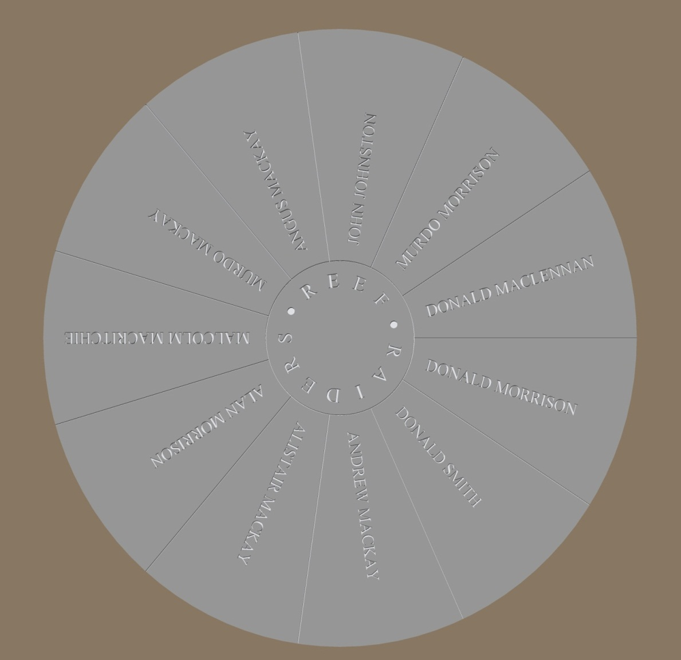
THIS IS A COMPUTERISED DESIGN OF THE GRANITE CIRCLE

Slide 19
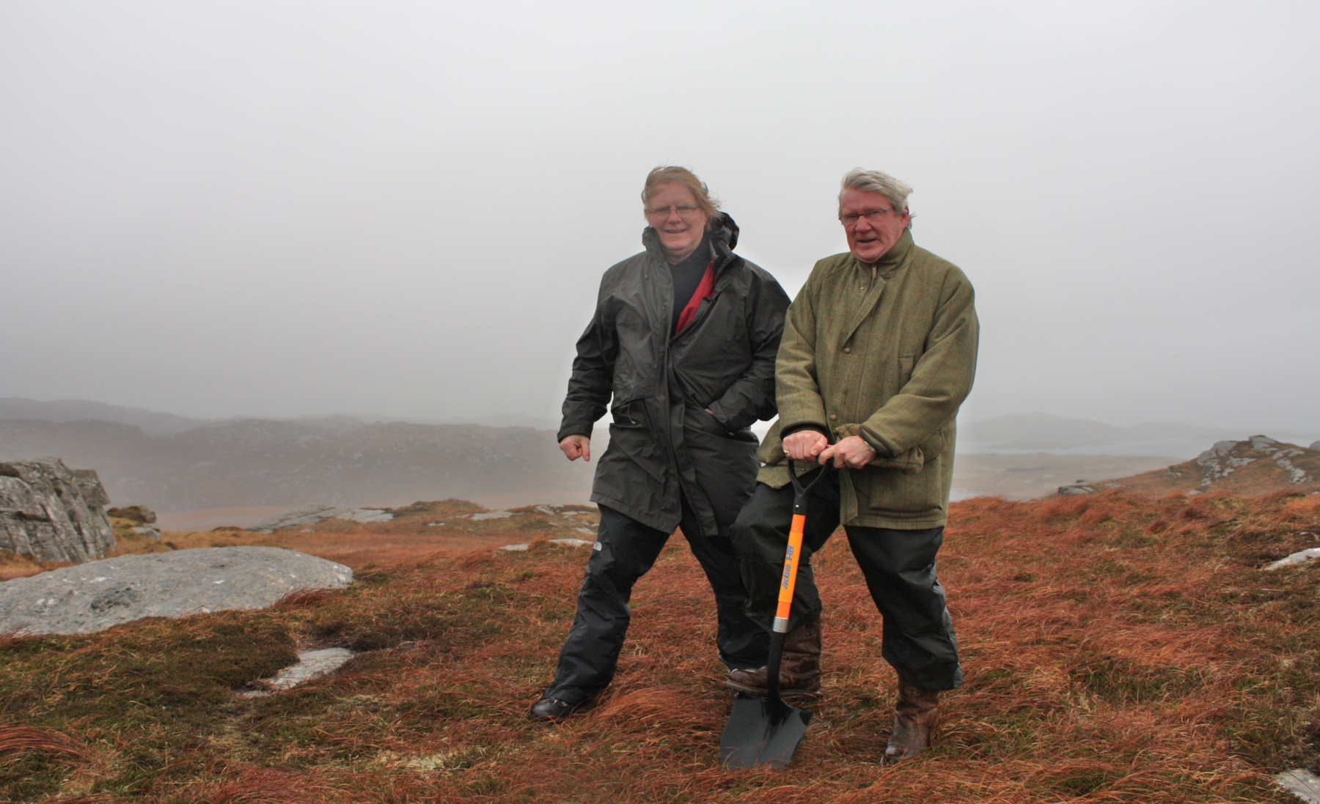
January 10th, 2012.
The best day for making the symbolic first cut into the turf was pretty wild and wet .
Will Maclean and Murdo Macleod, Chair of the Bhaltos Trust, manage a smile for the camera.

Slide 20
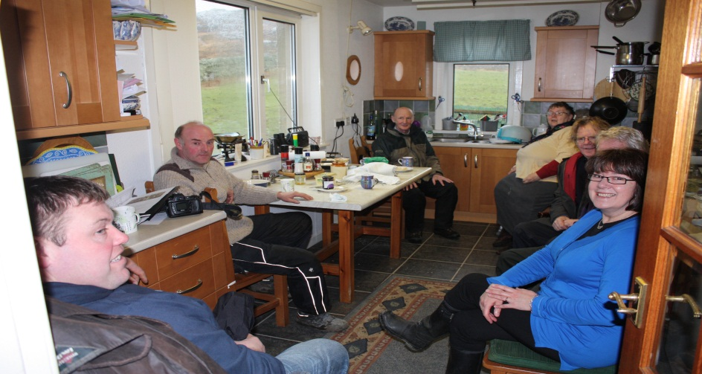
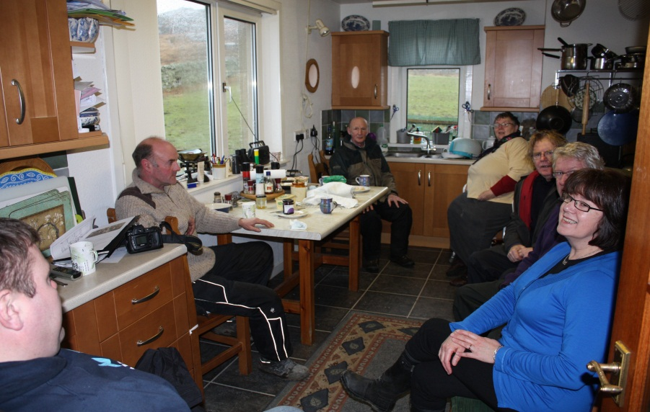
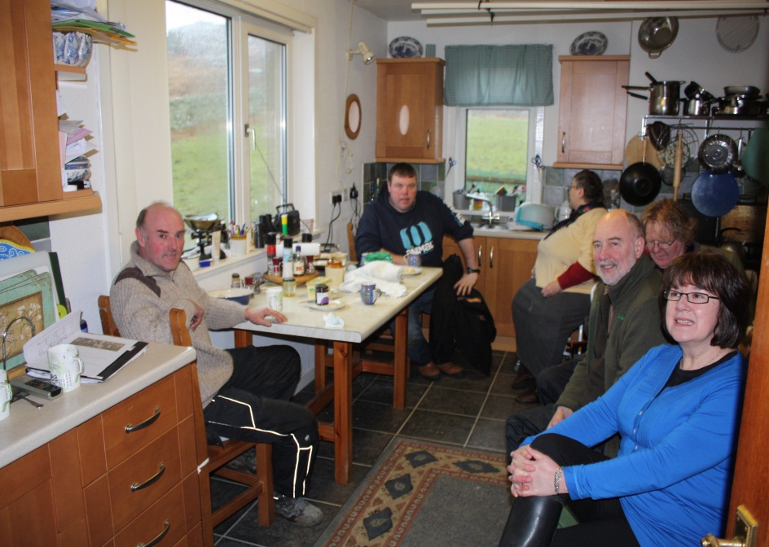
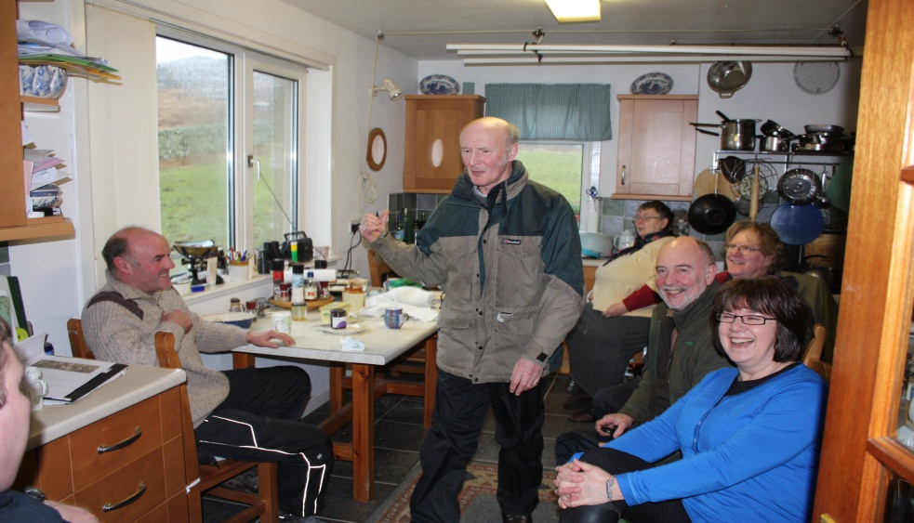
THE REEF PARLIAMENT
The first meeting of the team to discuss the way forward. Catriona provided endless hospitality and most of the planning and problem solving took place at No7 Reef.

Slide 21
TASKS AND CHORES LIST
Collaborate with main design team and task force
Apply for Planning Consent
Excavate a road and a parking bay
Find stones and transport to site
Search for archway stones, clean and stabilise them and transport to site. Erect on site.
Check names of Reef Raiders and historical context
Design and order a granite circle
Design and order a notice board
Find a blacksmith for the brazier
Find a suitable stone for the brazier
Order wood for the seating
Buy gravel for pathway and spread
Put granite circle, seating, beacon stone and brazier into circles
Liaise with MacTV and newspapers
Organise a ceilidh
Send monthly updates to Bhaltos Community Trust
Organise the Dedication Ceremony and ceilidh
For the duration of the project, a few tasks and chores lists were
created to keep everybody on track and to work to a rough timescale.
These were amended as time went on to take into account running out of stones (!!), machinery breaking down, illness and accidents, holidays and abysmal weather, as well as co-ordinating the work schedule.

Slide 22
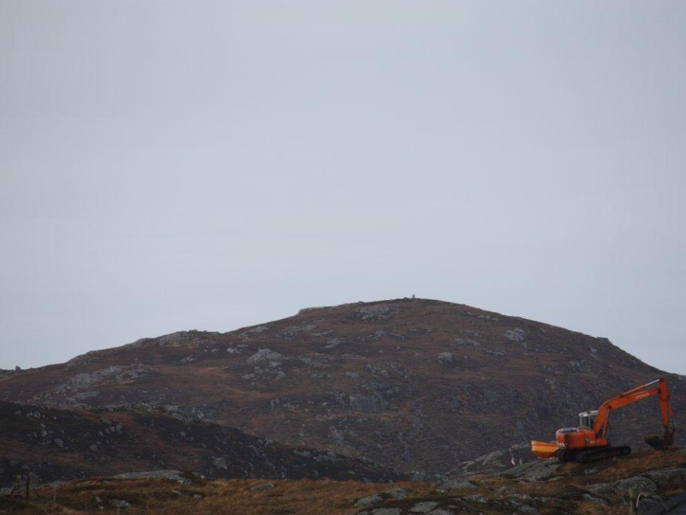
A SIGN THAT THE REAL WORK WAS ABOUT TO BEGIN.
One cold, dark morning, a digger appeared on the hillside.

Slide 23
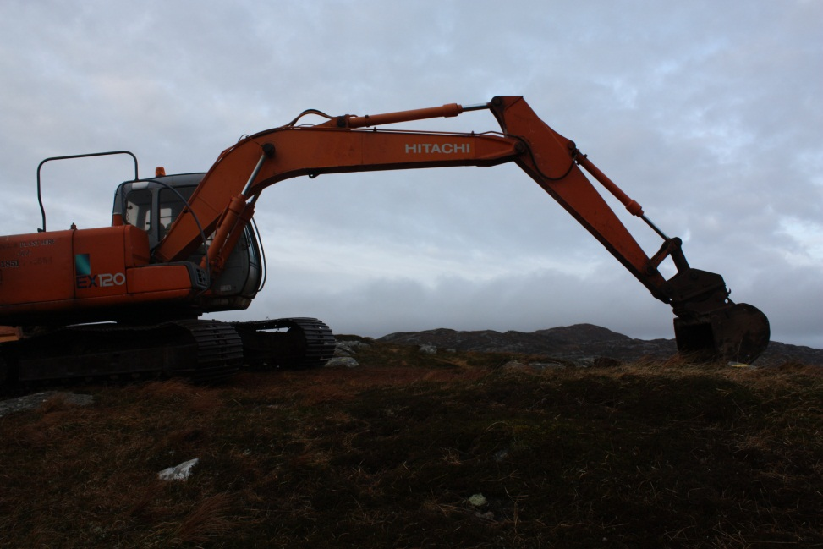
WORK COMMENCED !!
The road was excavated and a turning place was cleared.
Ready for action!

Slide 24
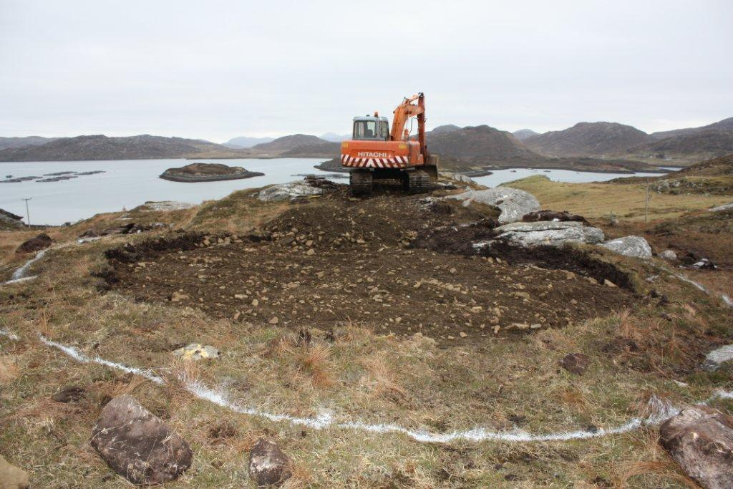

Slide 25
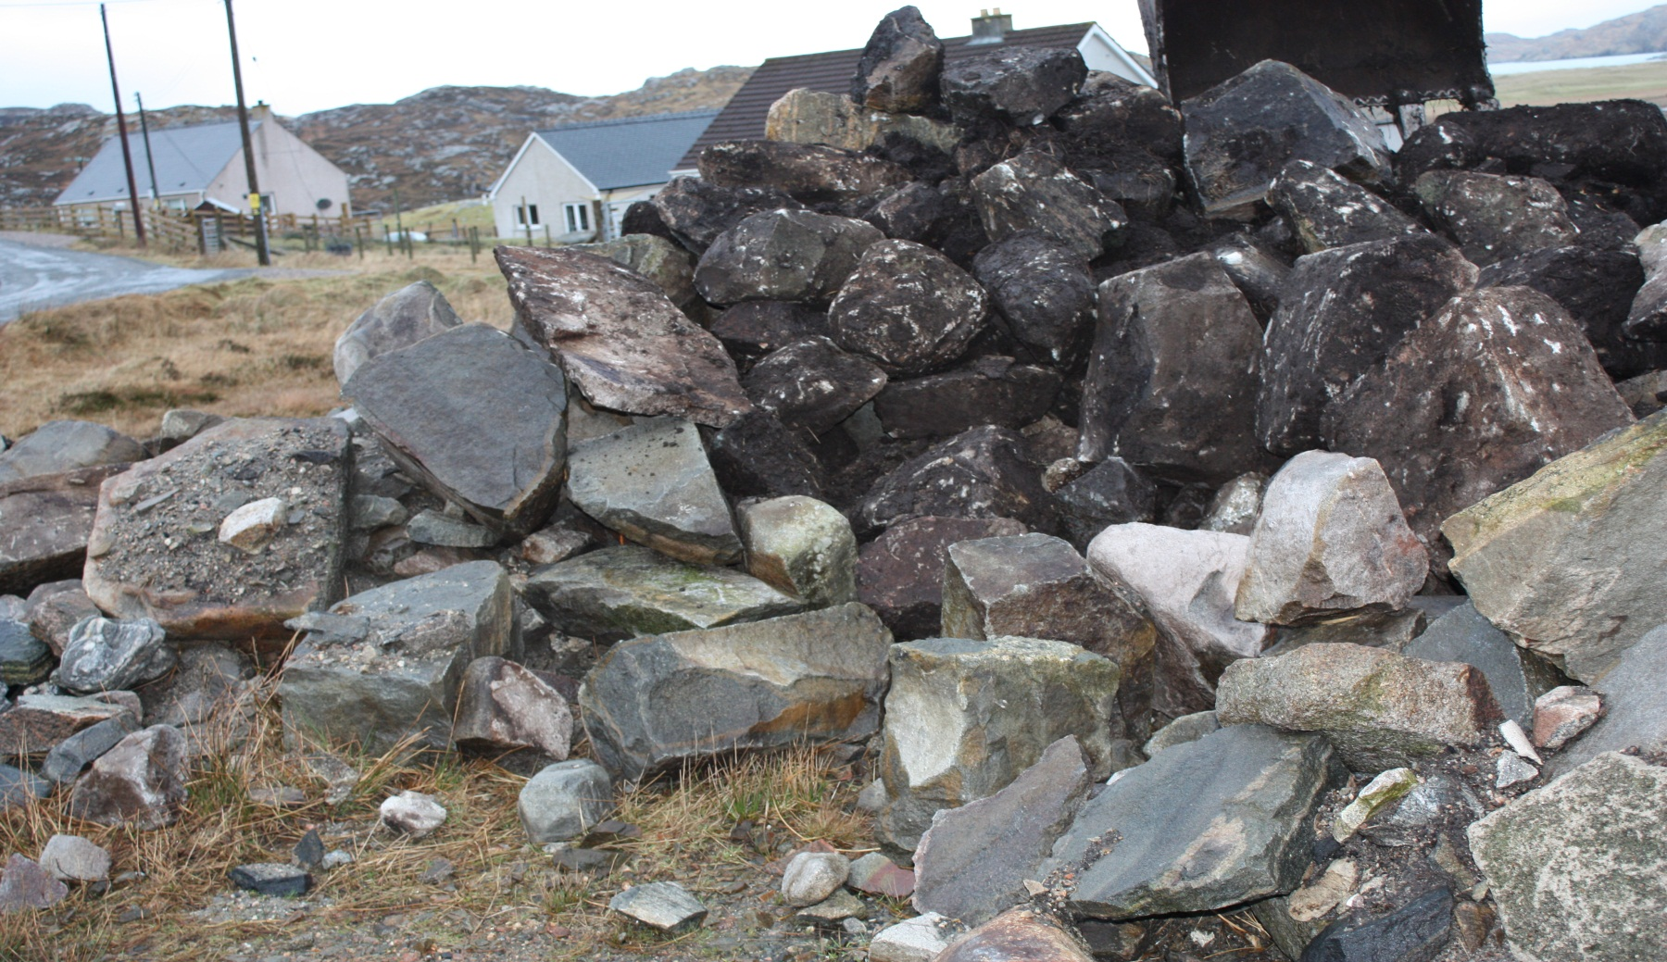
…………………..AND THE STONE BEGAN TO ARRIVE!!
Norry sourced some stones and Dolu transported lorry loads of them to the site after he had created the road and parking area.

Slide 26
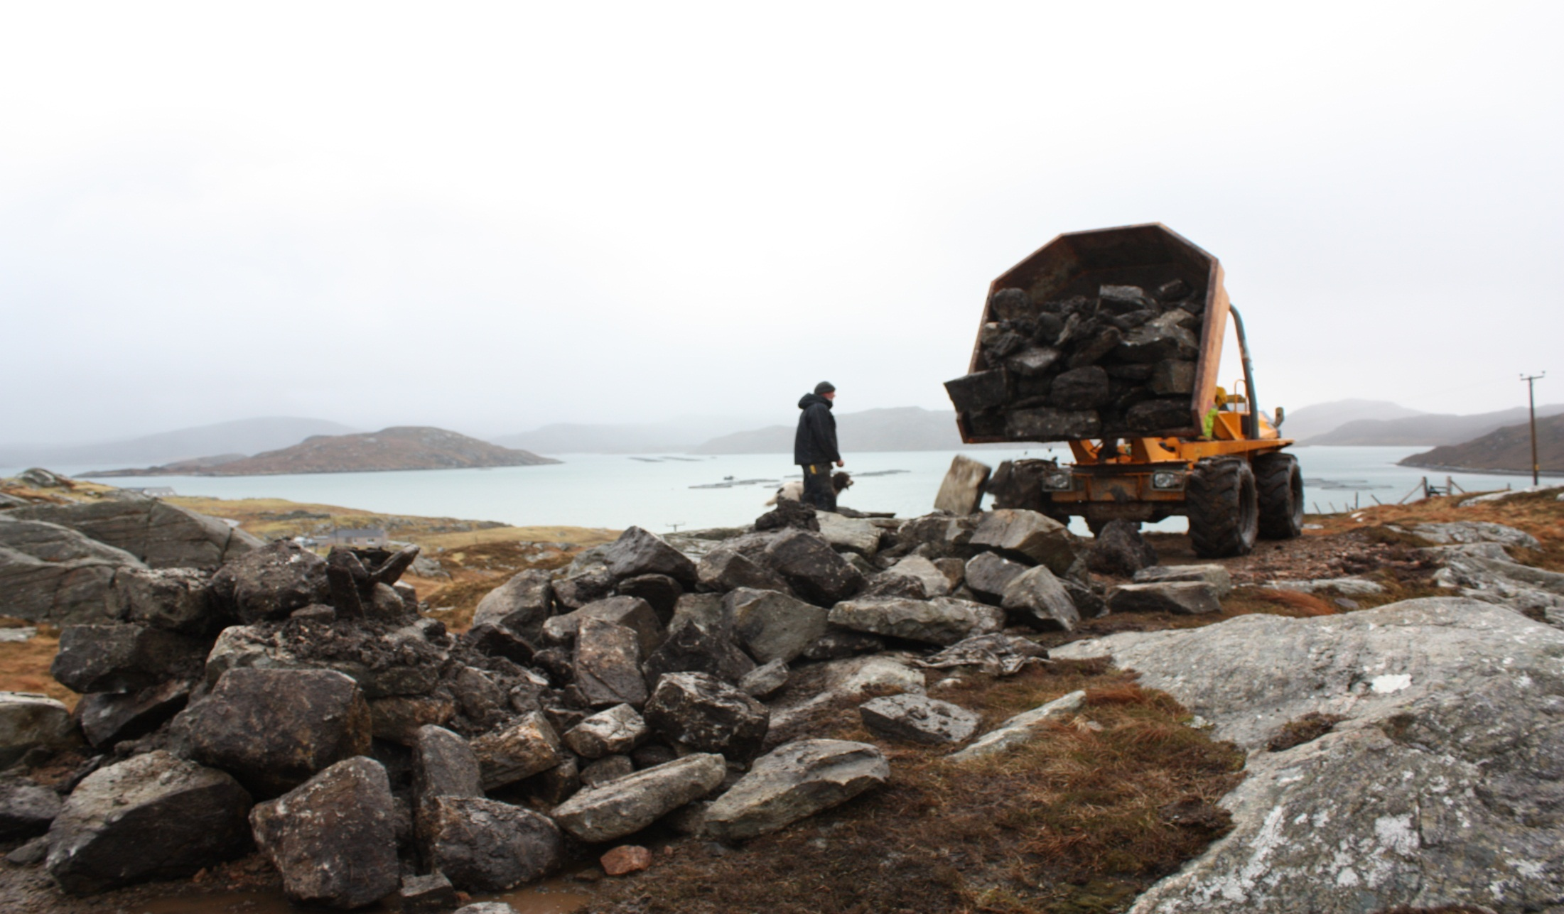
IAN SMITH SUPERVISED THE UNLOADING OF EVEN MORE STONES

Slide 27
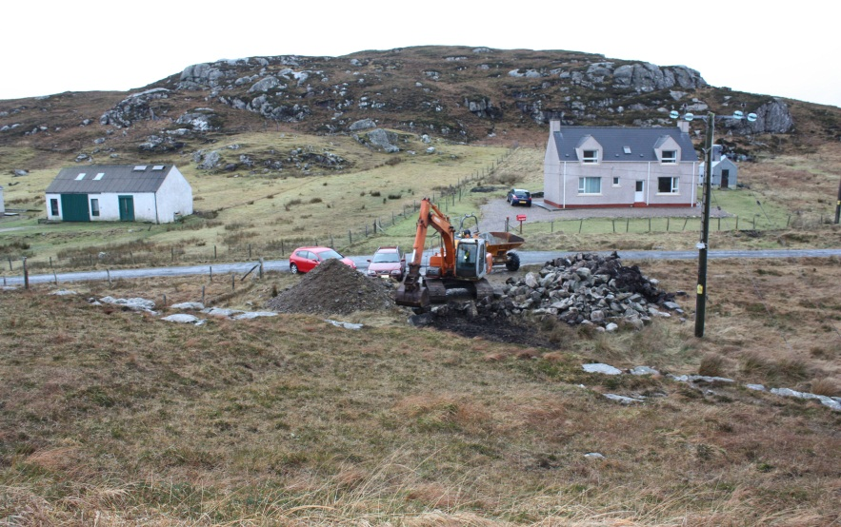
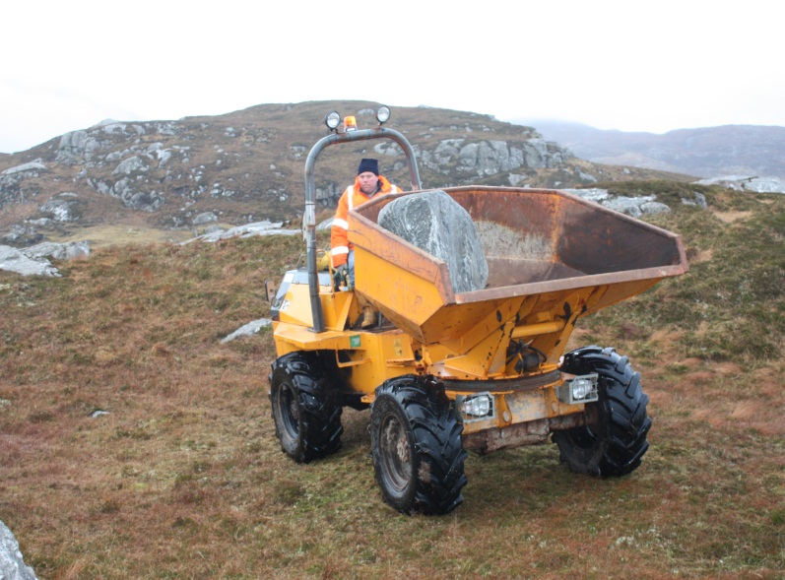
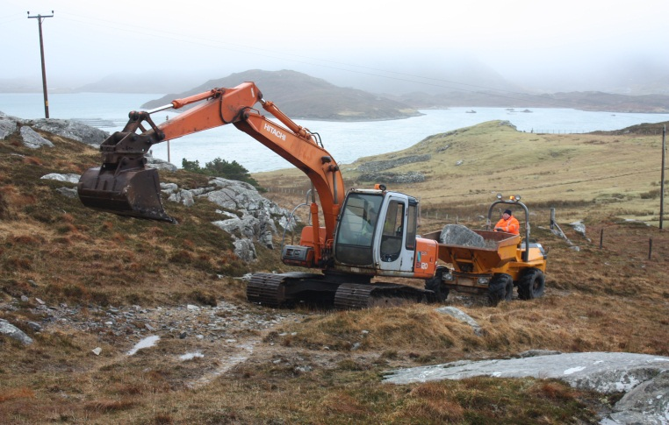
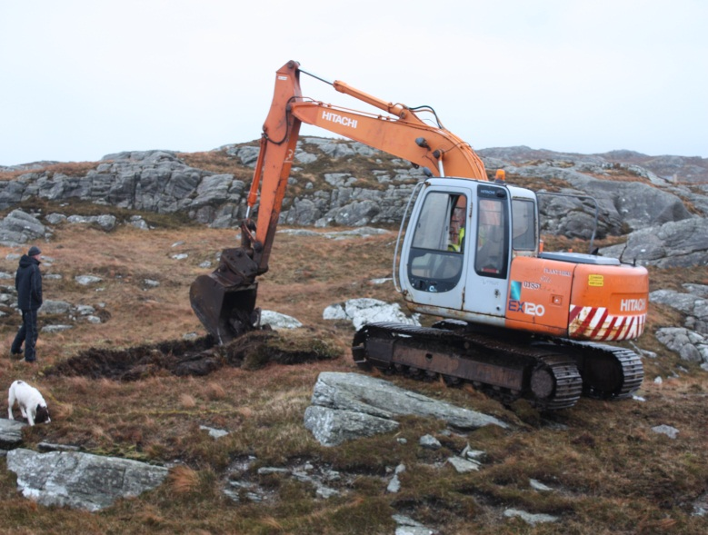

Slide 28
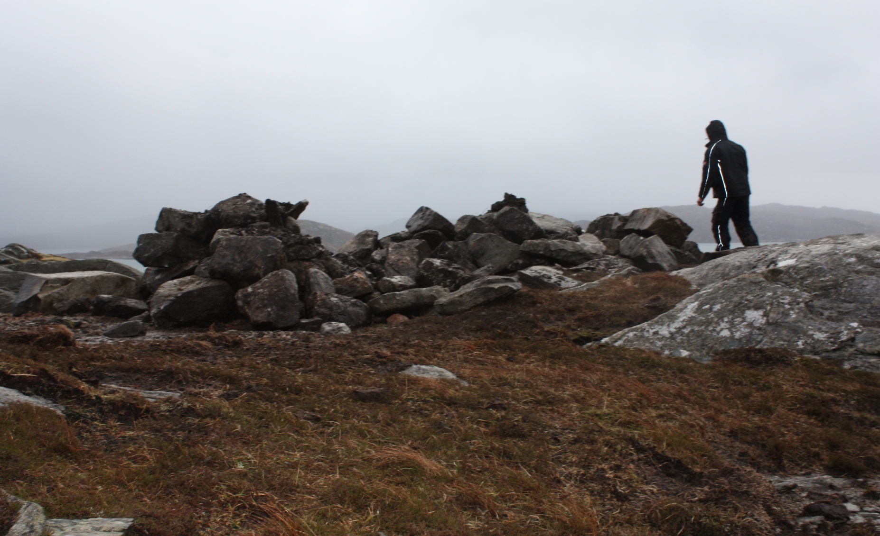
SORTING OUT THE STONES

Slide 29
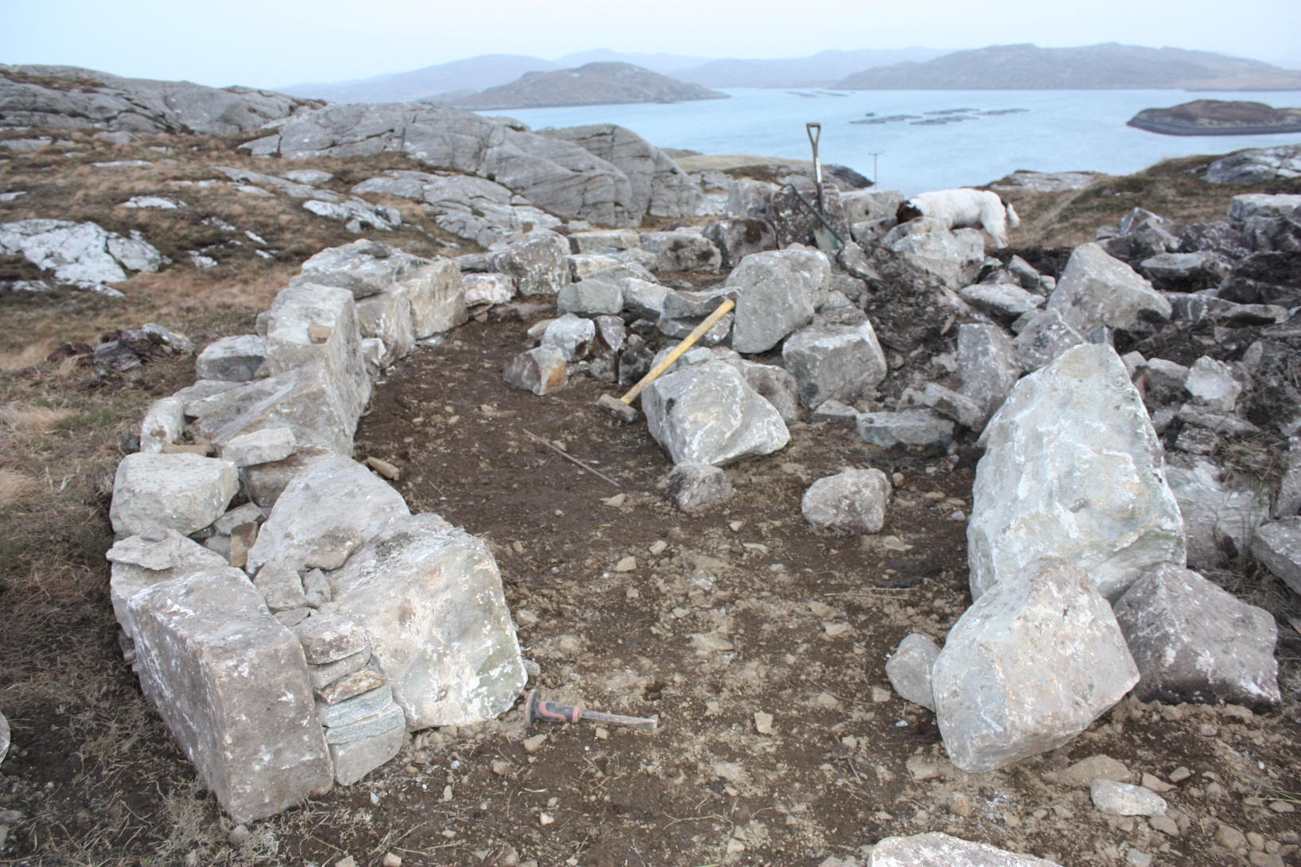
The stones came from old buildings in Uig – recycled to form the walls of An Sùileachan in Reef. They were very heavy and needed to be transported, lifted and shaped –laborious and time-consuming work.

Slide 30
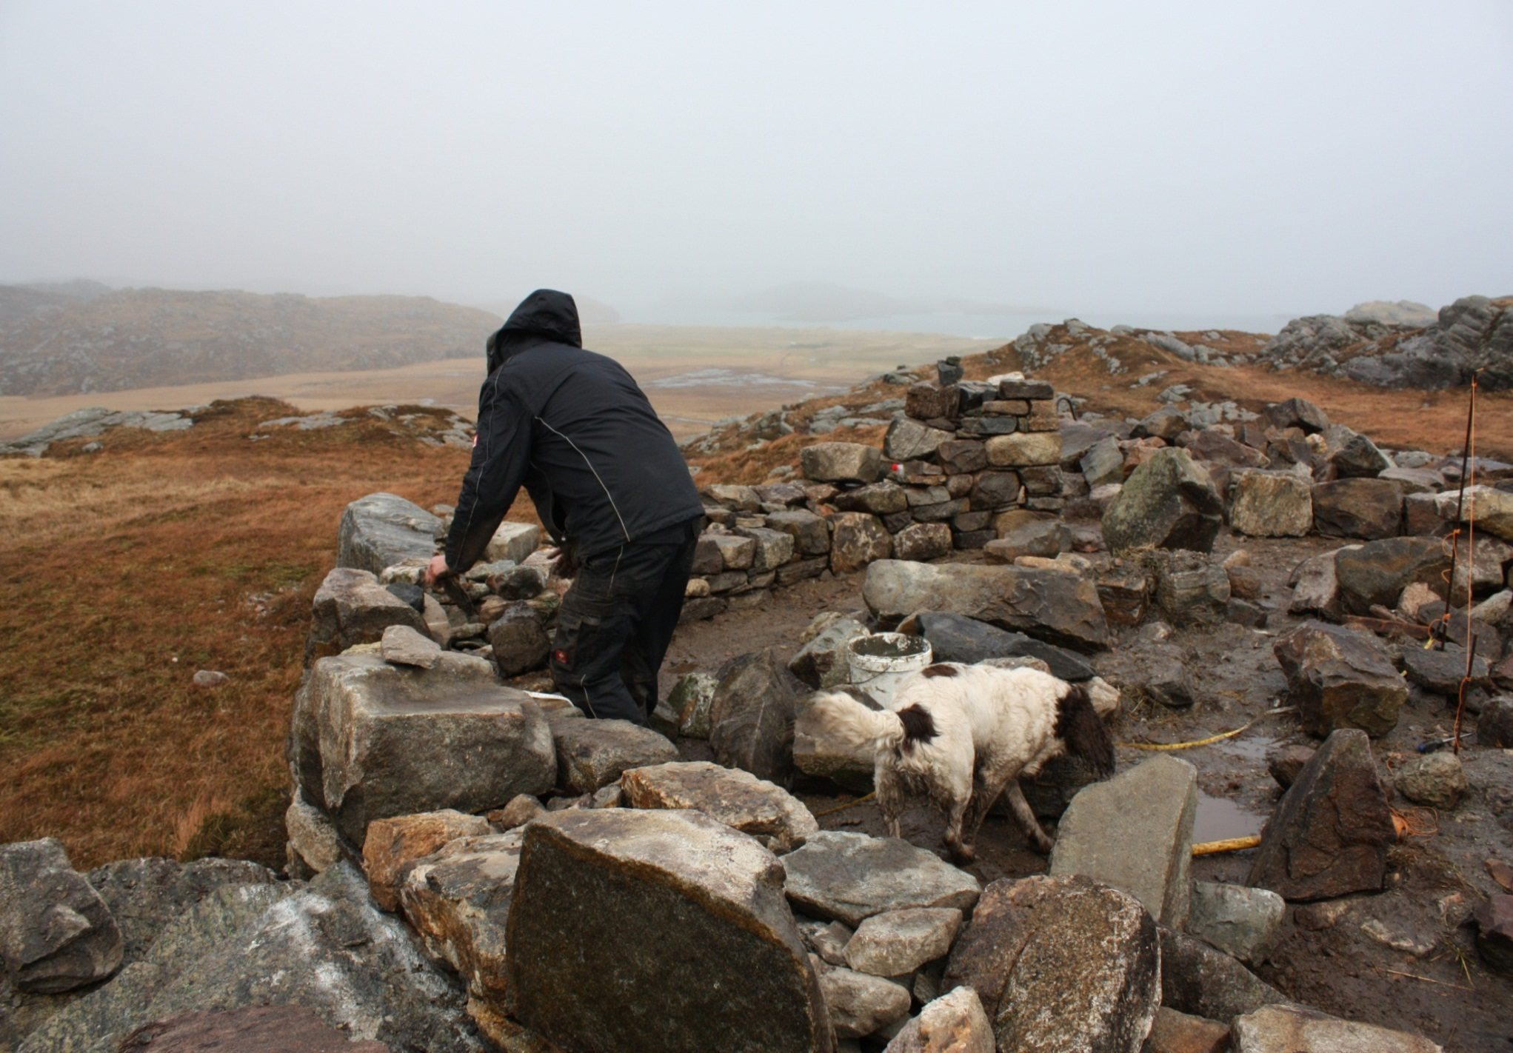

Slide 31
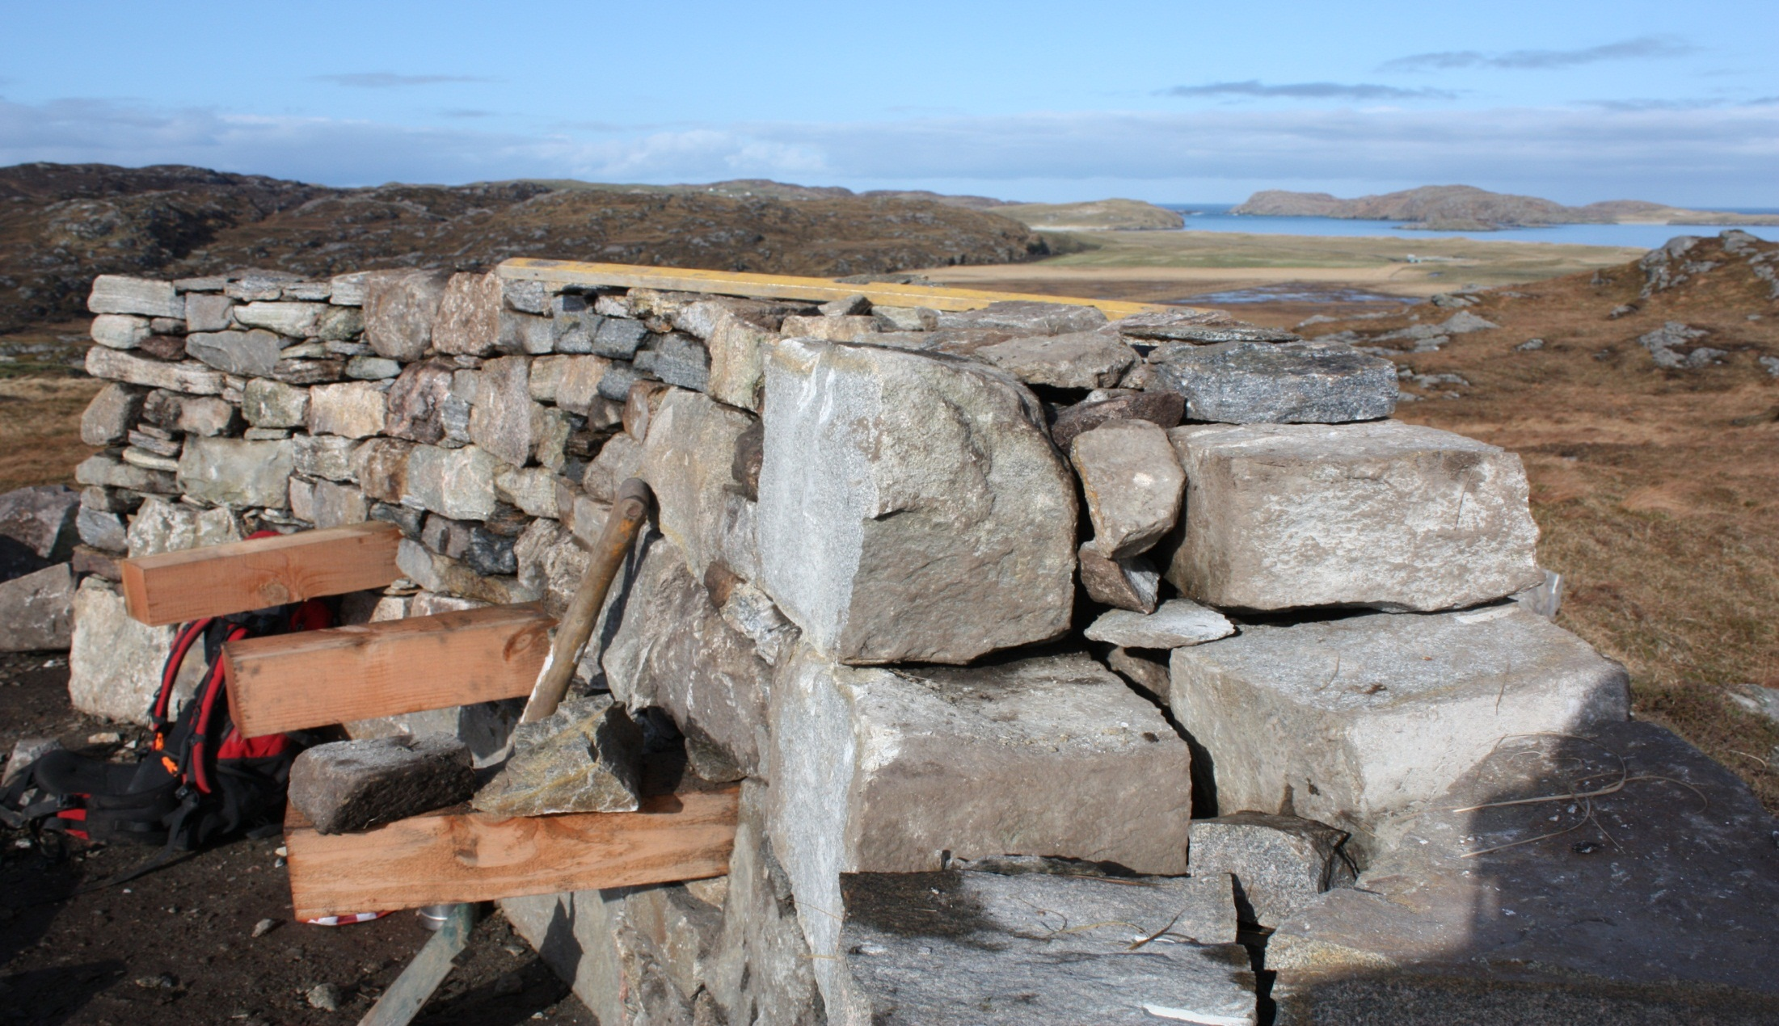
The first part of the circle and panoramic views over to Reef Beach
Notes:
The Raiders’ Circle showing the style of the stonemasonry.

Slide 32
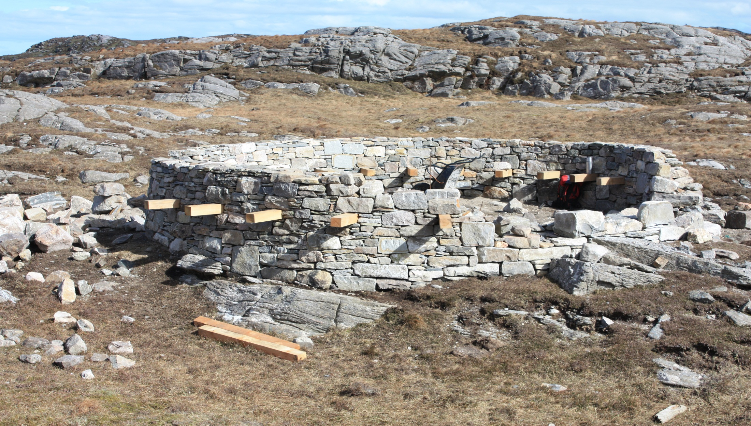
The first circle leading into the walkway. The wooden pieces will support the seats.

Slide 33
Jim Crawford had been looking for suitable stones for the archway for quite some time.
On Will’s last trip with Jim, they were lucky enough to find exactly what they were looking for on an island called Vuia Beag.
The stones were near the low water mark and Jim spent some considerable time measuring and preparing them for removal to his workshop.
The Scottish Salmon company kindly provided a boat to take them off the island and they were transported to Garynahine by lorry. They had to be dried off , cleaned and shaped.

Slide 34
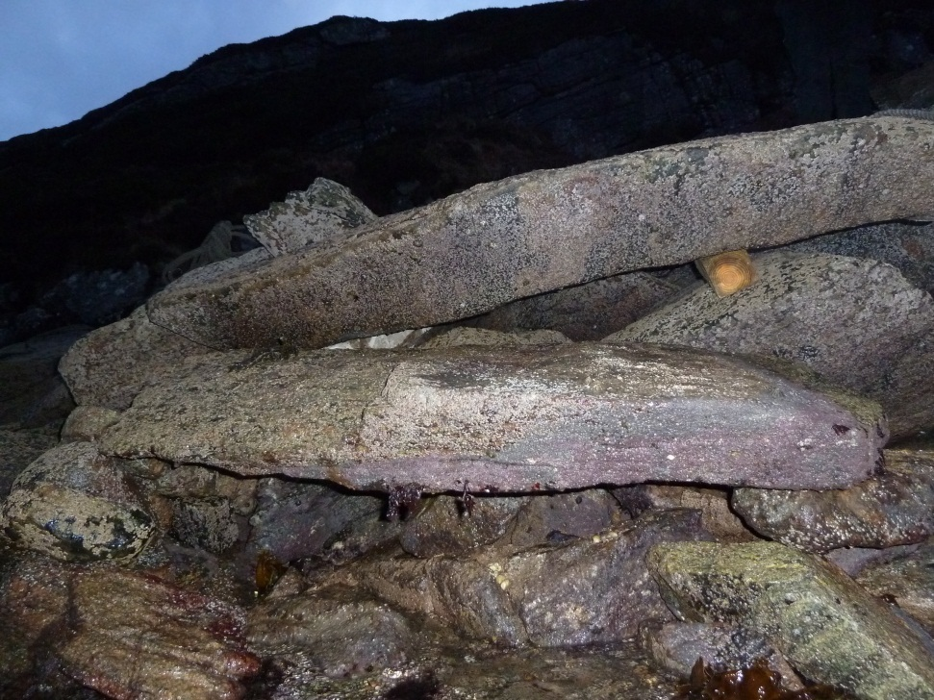
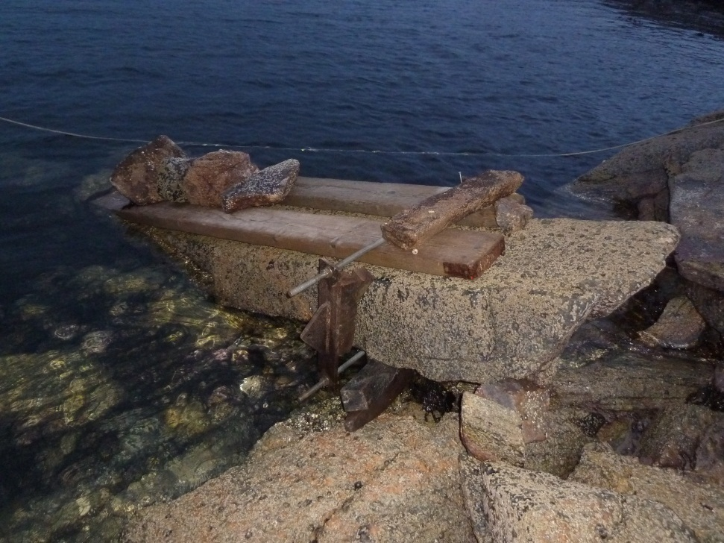
THE PERFECT SHAPE, AND SIZE FOR THE ARCHWAY
Sourced, moved and transported by Jim Crawford

Slide 35
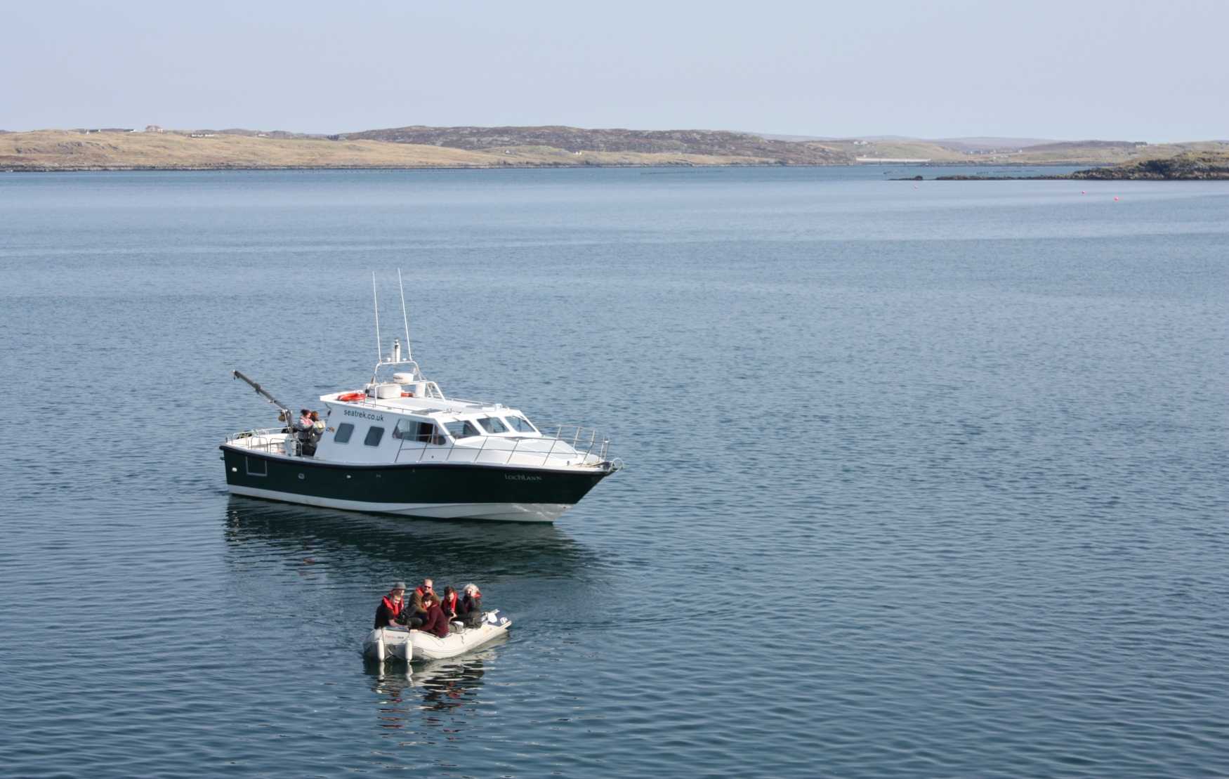
The film crew and some guests were transported to Vuia Beag on Lochlann to see the stones being lifted.
Thanks to Janet and Murray Macleod of Sea Trek and Lynne and Calum Buchanan for their generous hospitality. The weather , of course, was simply stunning.

Slide 36
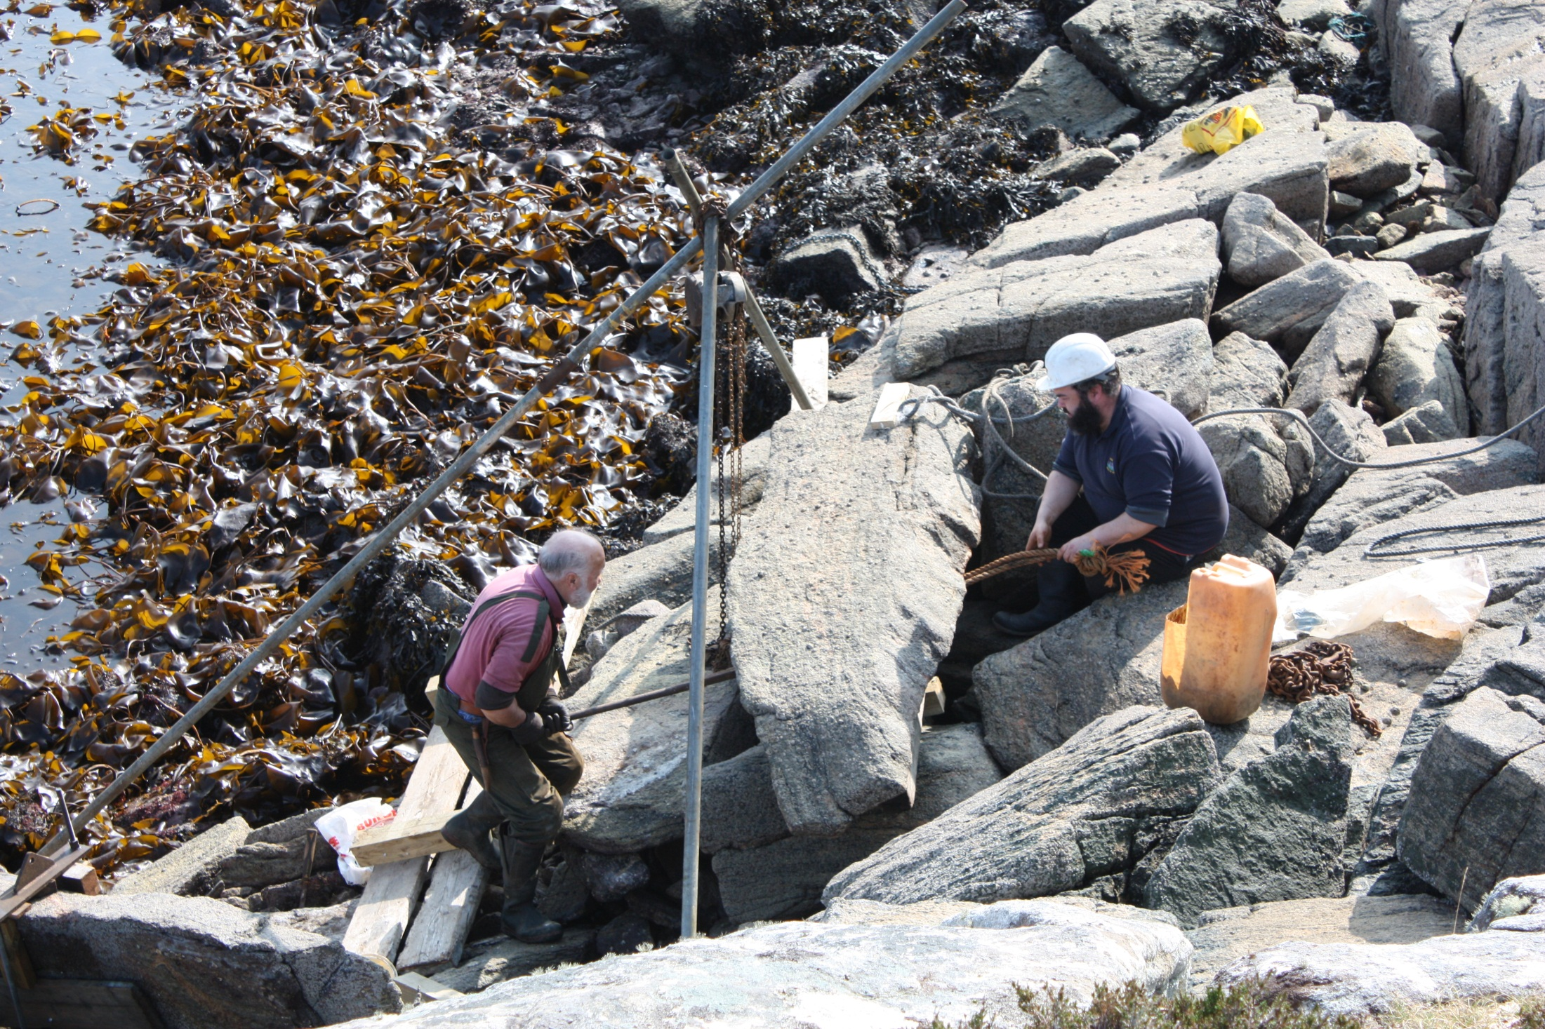

Slide 37
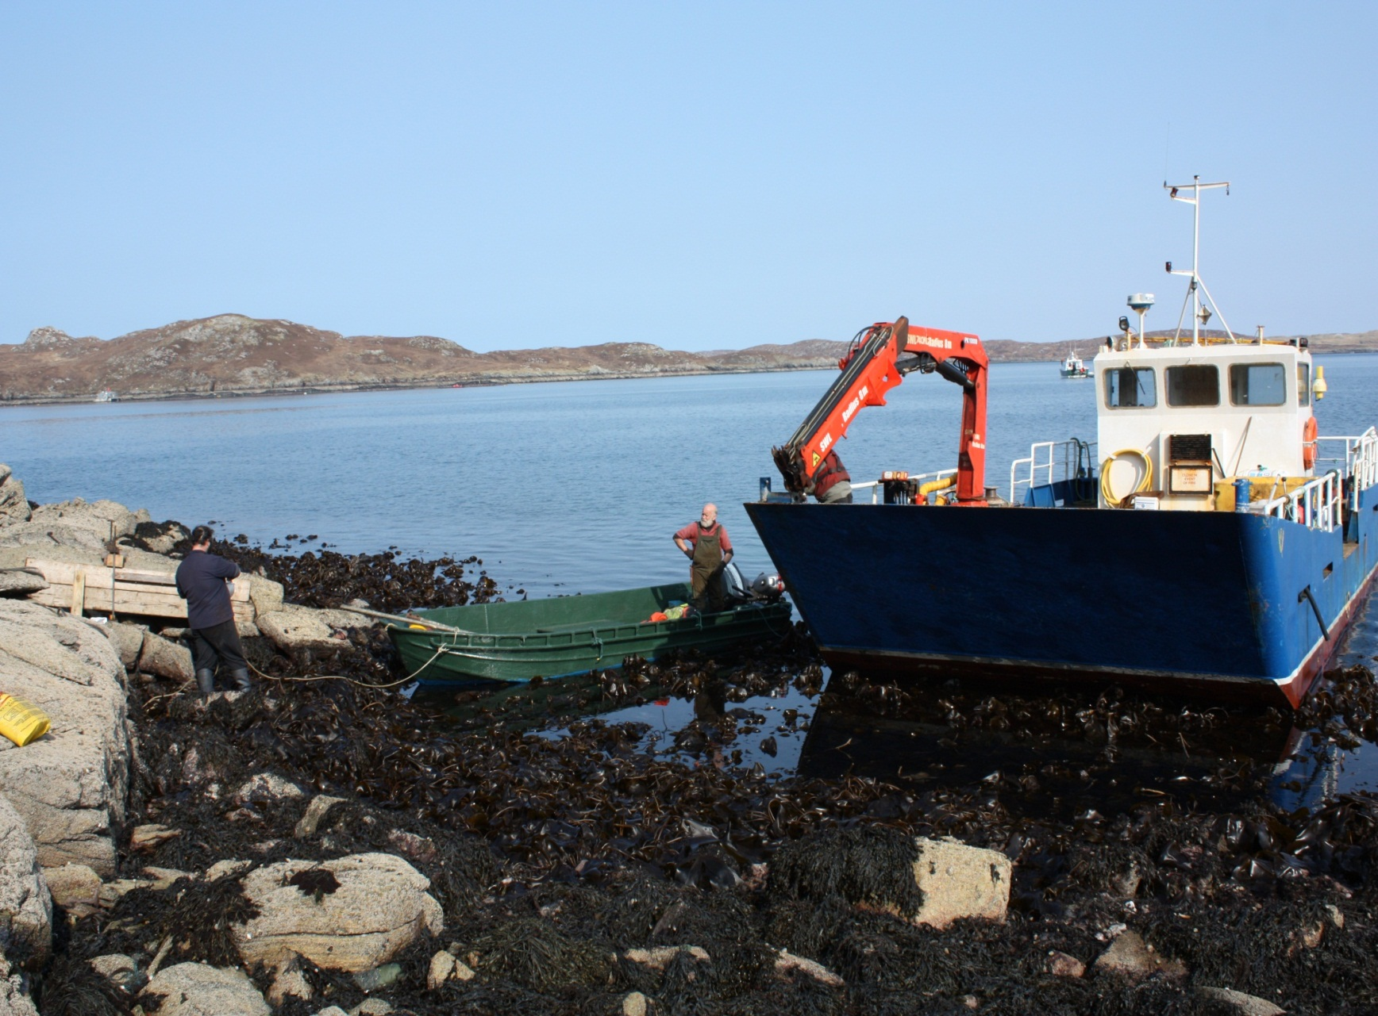

Slide 38
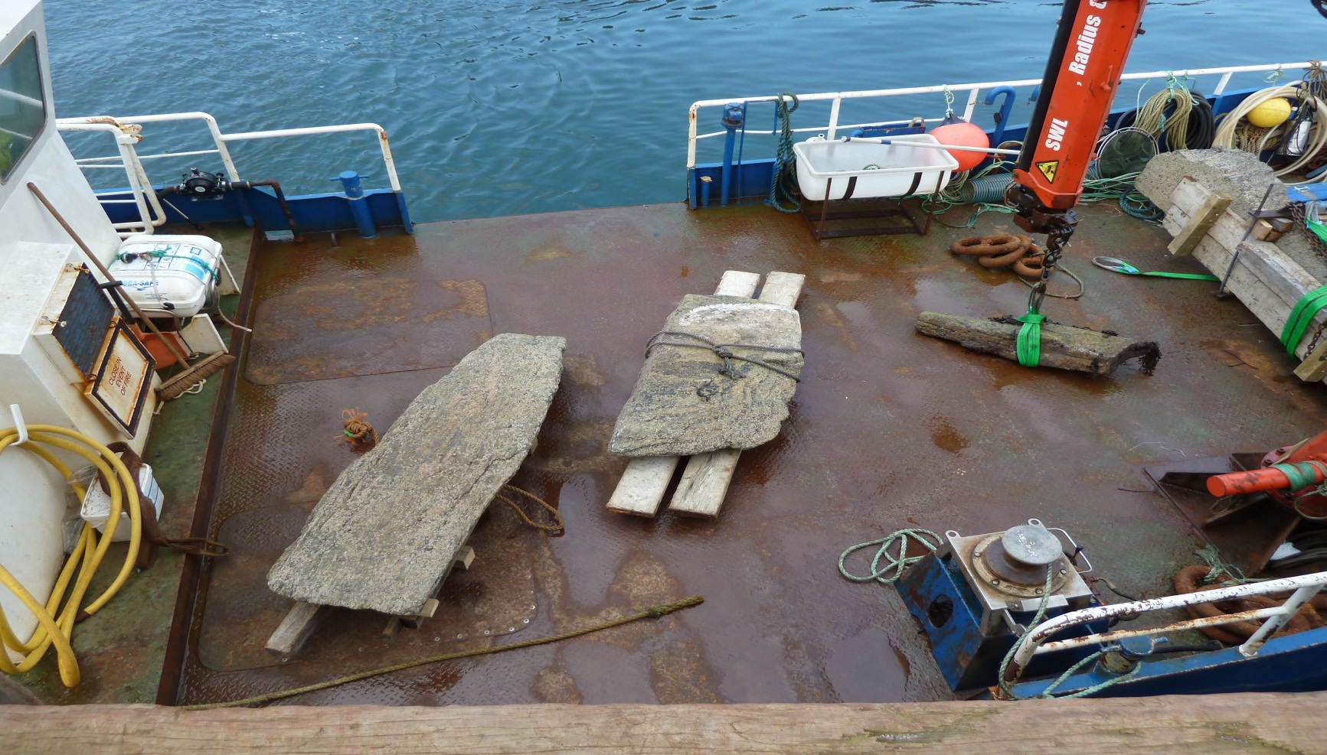
Stones being shipped to Jim’s workshop to be checked over and shaped.

Slide 39
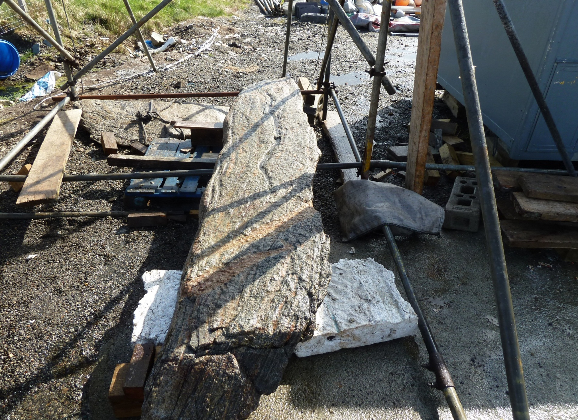

Slide 40
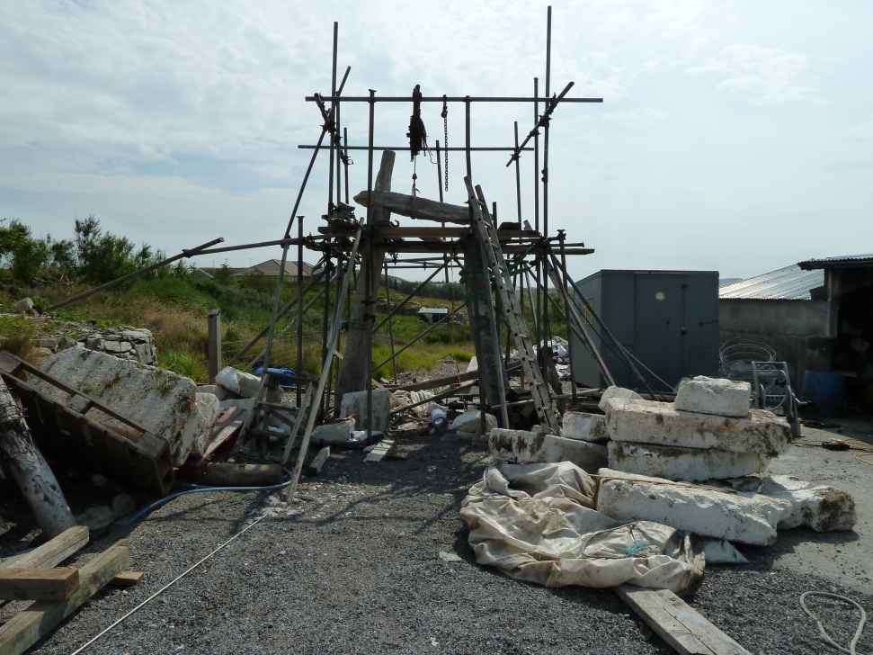
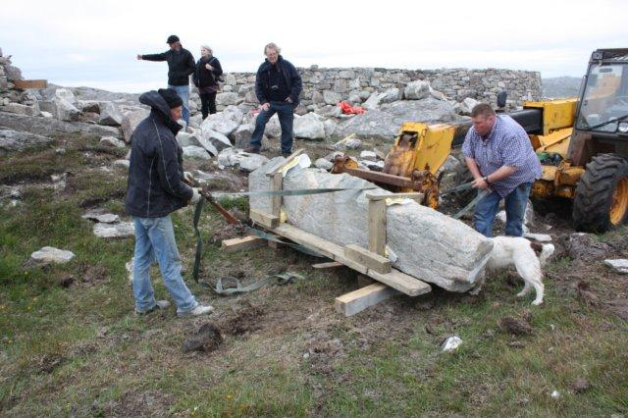
After cleaning the stones, Jim constructed a mock-up of what they would look like in their final position and Norry hauled the stones up to the site, ready for setting into place.

Slide 41
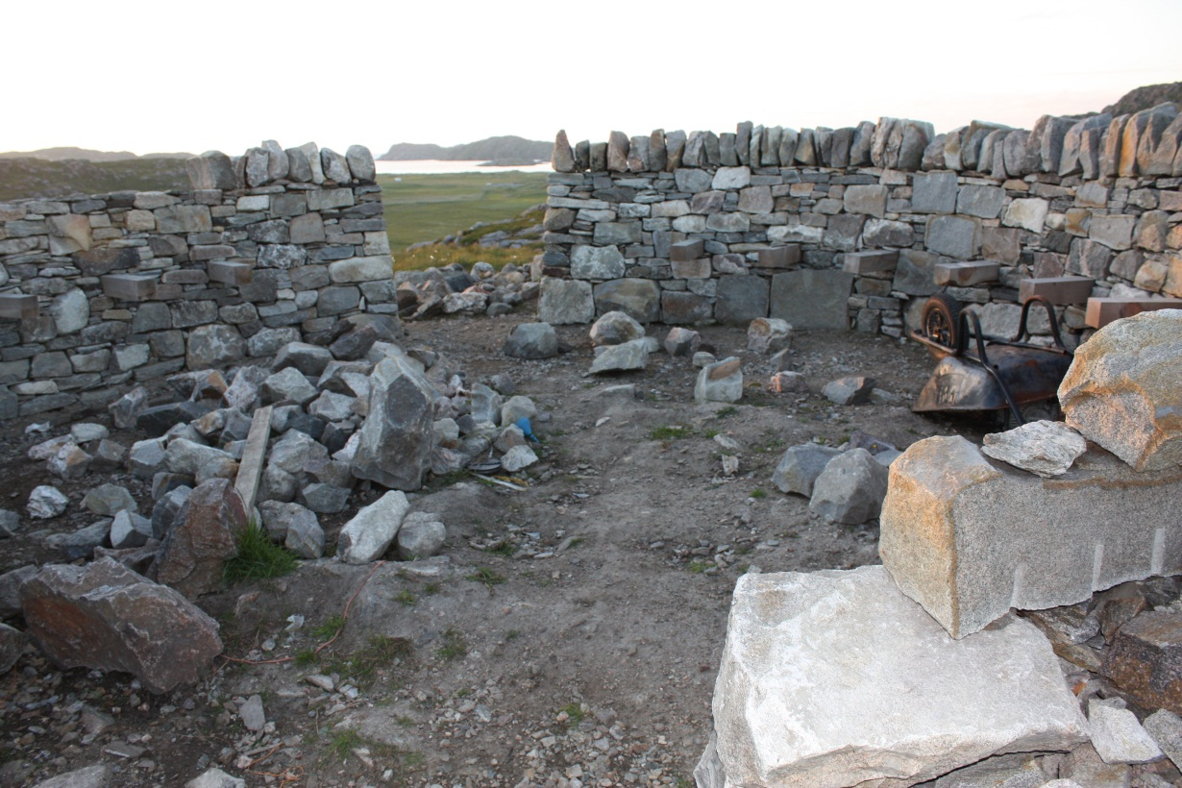
THE LAST FEW STONES
The stone walls were a work of art in themselves – beautifully fitted together to create the circles. Because they had come from old byres and buildings, they were very large and heavy and it took time to move them, split them , shape them and fit them.
However, everything came together despite the wind and the rain and the hail .
In this photo, the walkway wall is just about finished and the capping stones are being put in place.

Slide 42
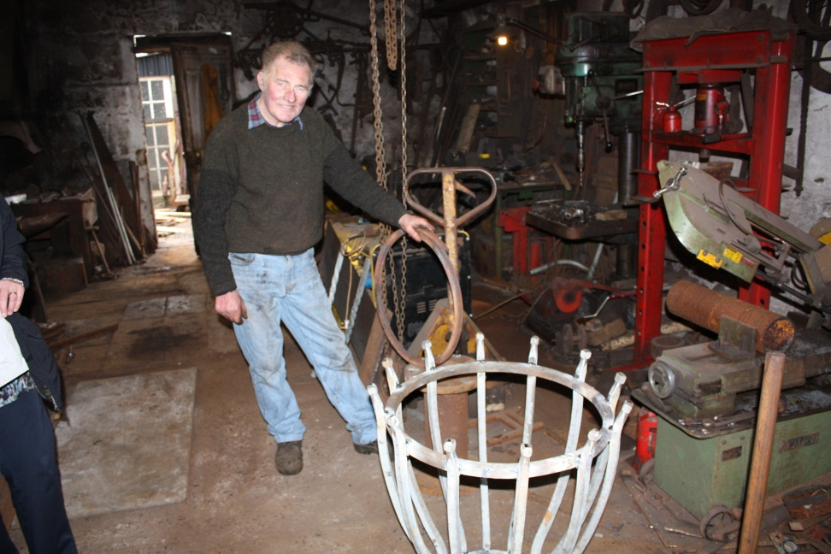
THE LOCAL BLACKSMITH IN STORNOWAY, JOHN MACLEOD, MADE THE BRAZIER OUT OF OLD GRAVEYARD RAILINGS WHICH ARE OVER ONE HUNDRED YEARS OLD.
IT HAS BEEN MOUNTED ON A MILL STONE IN ONE OF THE CIRCLES.

Slide 43
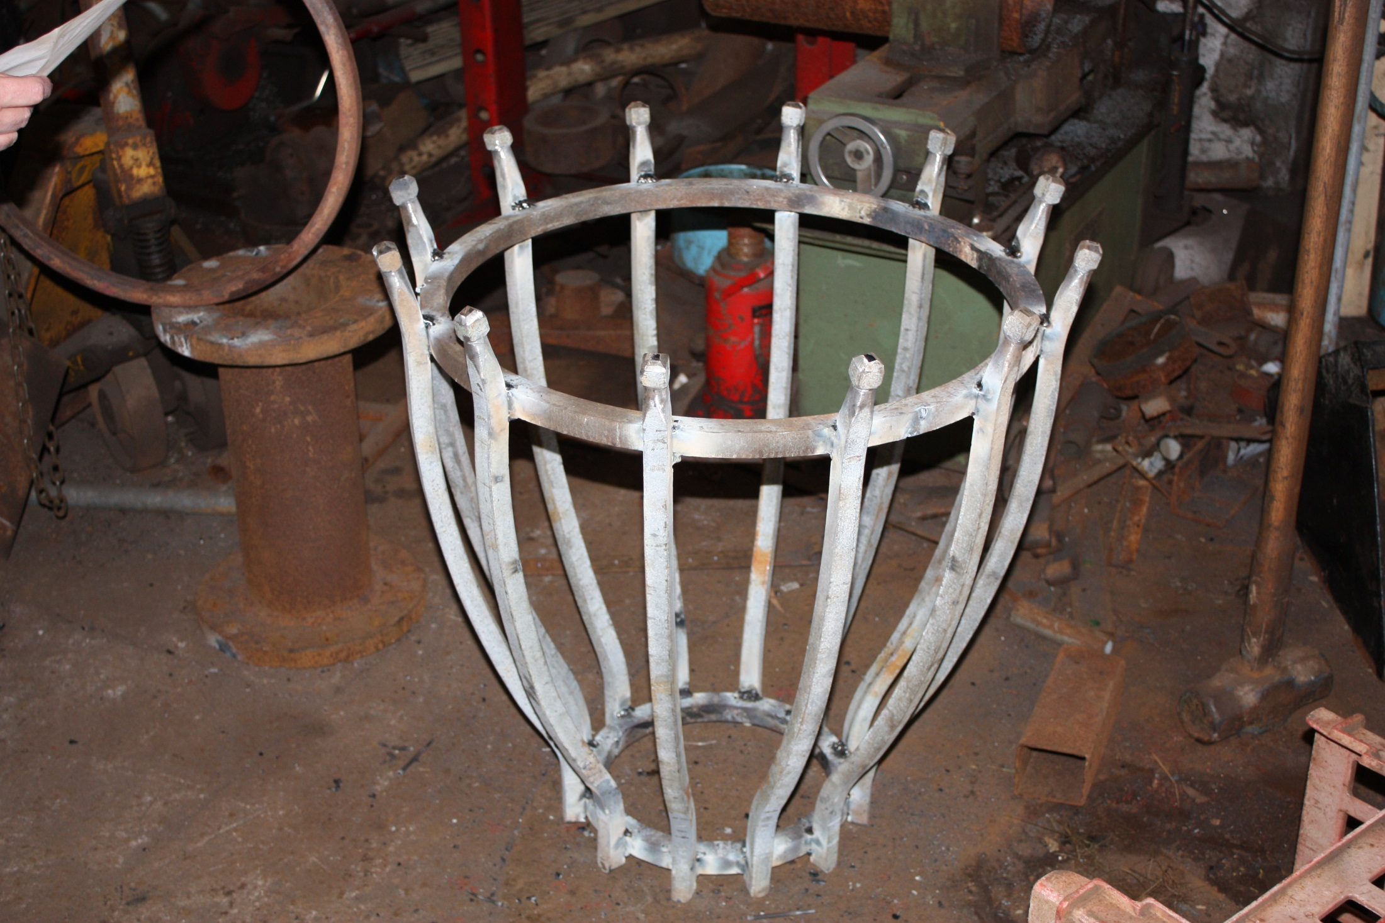

Slide 44
COMMUNITY INVOLVEMENT
We wanted to host a ceilidh to involve the community to raise awareness about the project and to involve as many of the Uig people as possible.
We decided to hold an exhibition in the Community Centre Tearoom, which would run throughout the summer season, to inform the public about the background to the project and to give a historical perspective about the Land Clearances, The Land Raids and the land reforms which led to the formation of the Bhaltos Community Trust.

Slide 45
THOUGHTS ON ISLAND LIFE
We thought that it would be good to find out about the life stories of some of the older people in our island community who had witnessed a great deal of change over one lifetime.
We were also keen to hear what the younger people in our community felt about island life, so we approached the school and spoke with the children. They wrote about their feelings and did some art work and were happy to provide some work for the exhibition. Their work covered The Clearances.

Slide 46
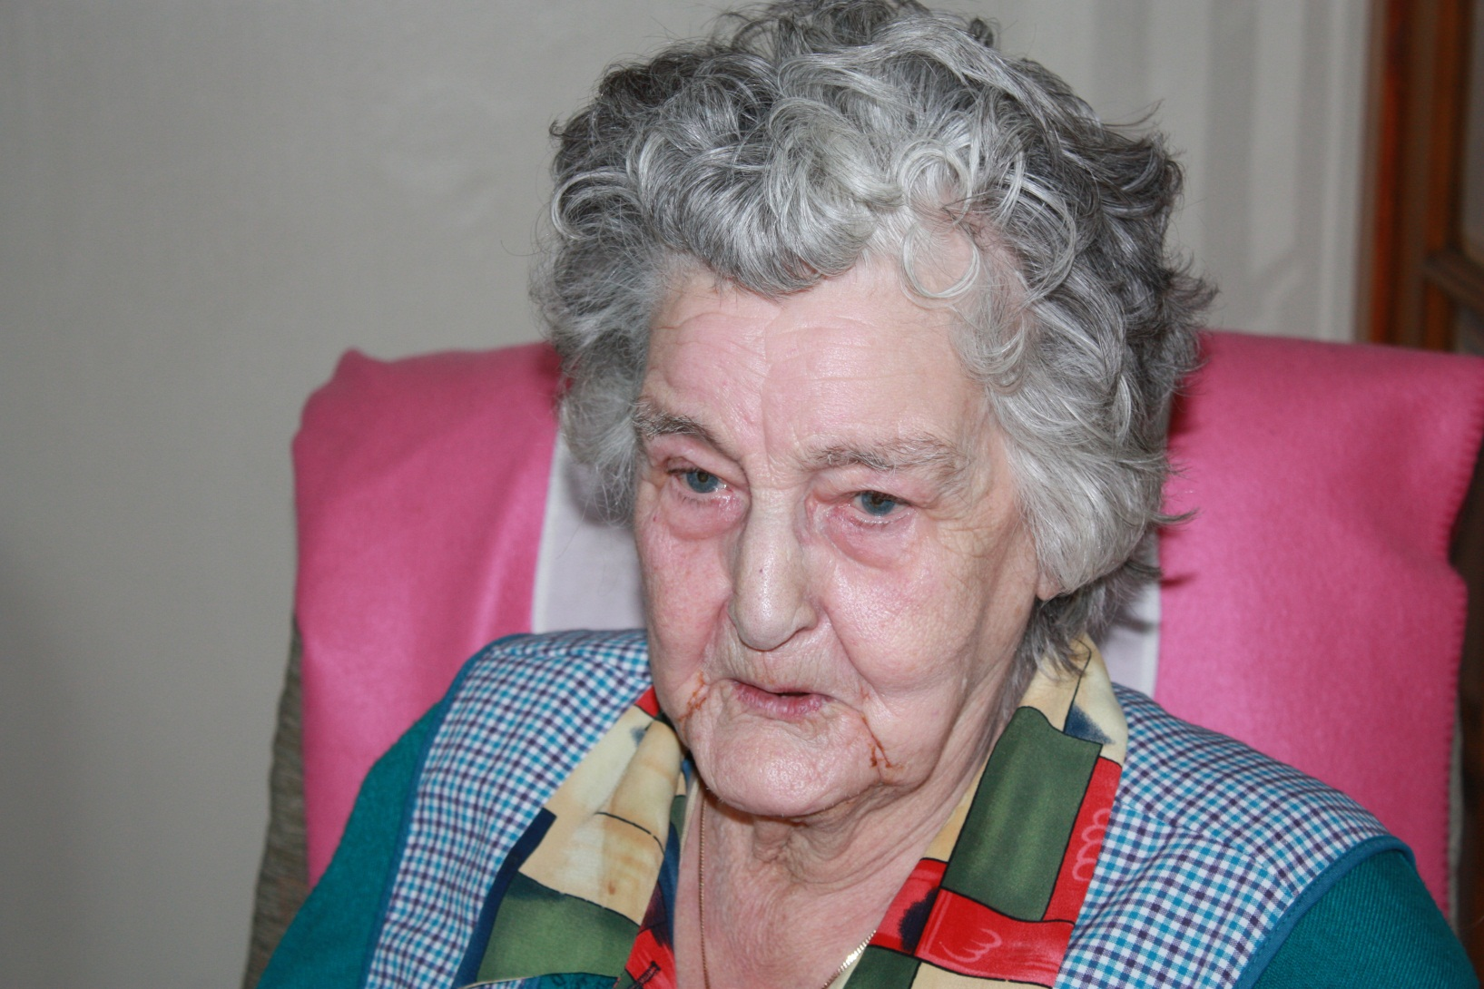
This is Flora Macdonald and she is 94 years of age. She lives in Reef and she told us her life story which was included in the exhibition in the tearoom.

Slide 47
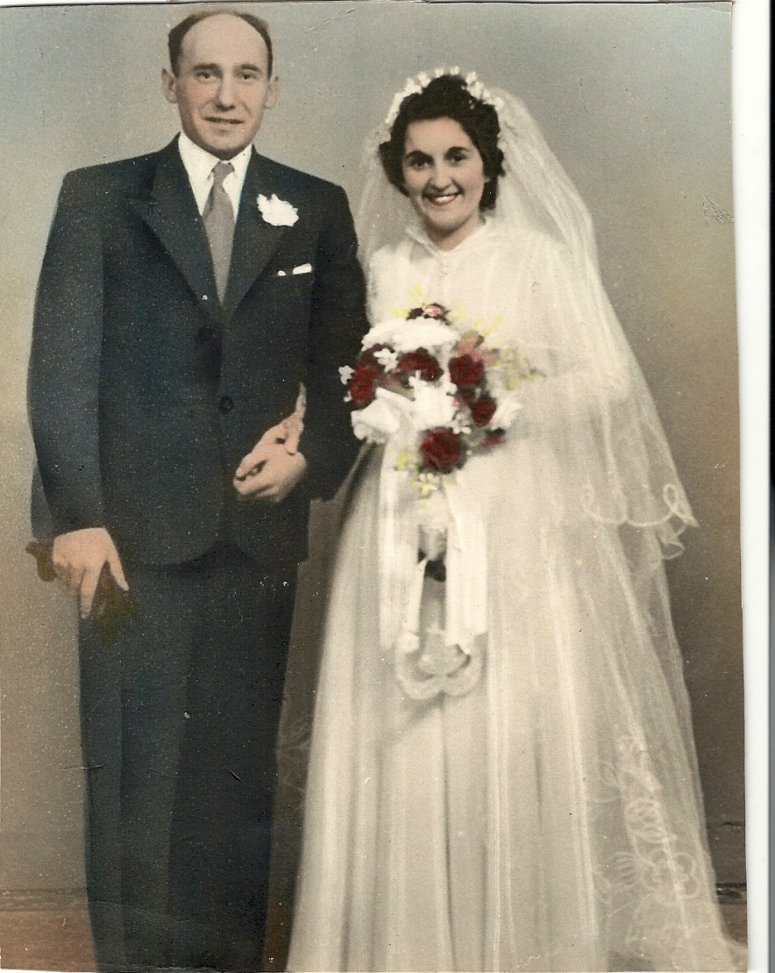
A Valtos Family -
Mairi Hearach’s Memories
She was born on the island of Scarp and came here for work. She met and married her husband here, settled in Valtos and raised her family.
Her lifestyle has changed a great deal since childhood . She lived in a blackhouse on a small Hebridean island called Scarp.
Her story was exhibited at the exhibition.

Slide 48
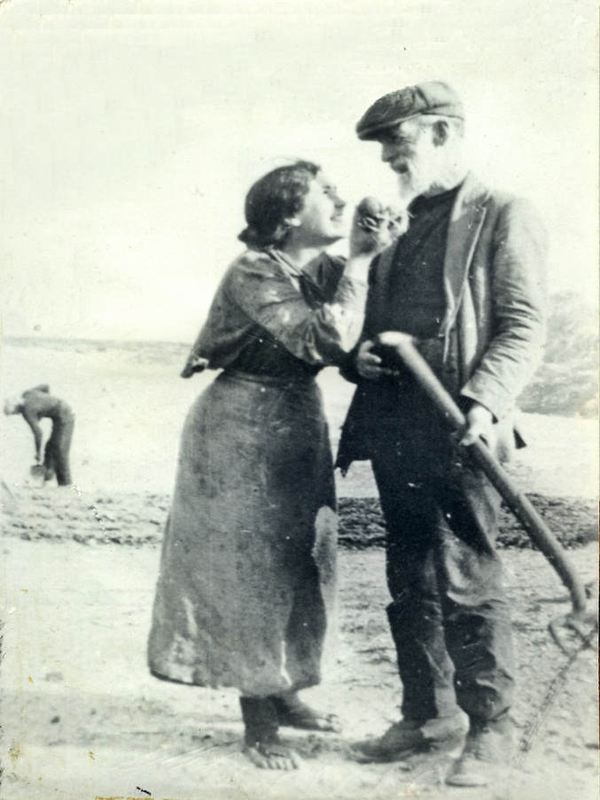
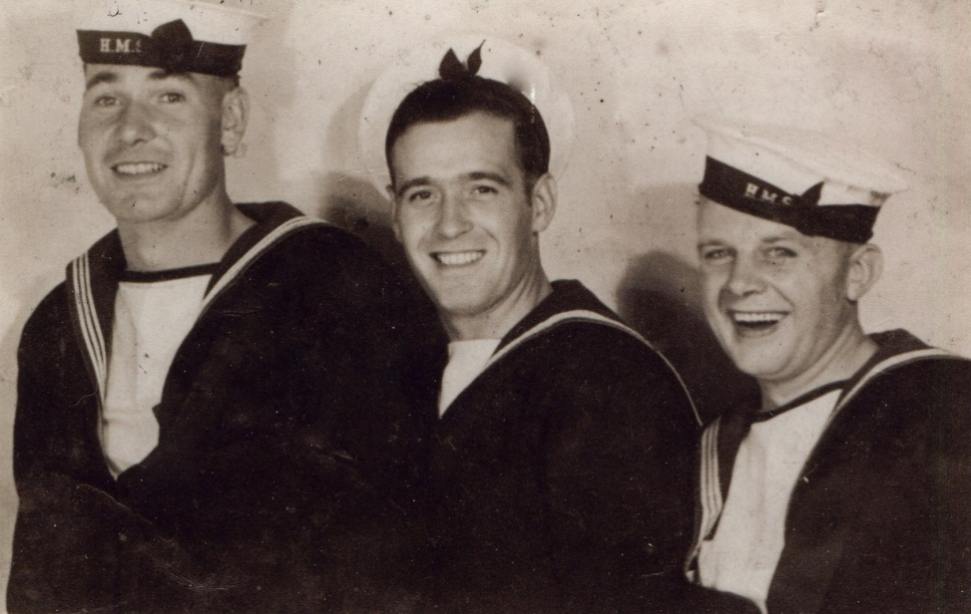
WE ARE LUCKY ENOUGH TO HAVE A WEALTH OF HISTORY AT OUR FINGERTIPS IN UIG!
VISITORS CAME TO SEE THE EXHIBITION AND TO RESEARCH
THEIR ISLAND ROOTS FROM THE MUSEUM FILES.
From the archives……………happy, local Merchant Seamen and note the footwear and apron in the second photograph

Slide 49
DonaldJ Macleod, formerly from Eneclete and now living in Bridge of Don Aberdeen, donated five War Graves Commission certificates relating to families of Reef Raiders.
They were put on display at the exhibition in the tearoom.

Slide 50
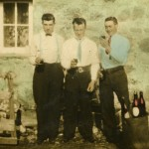
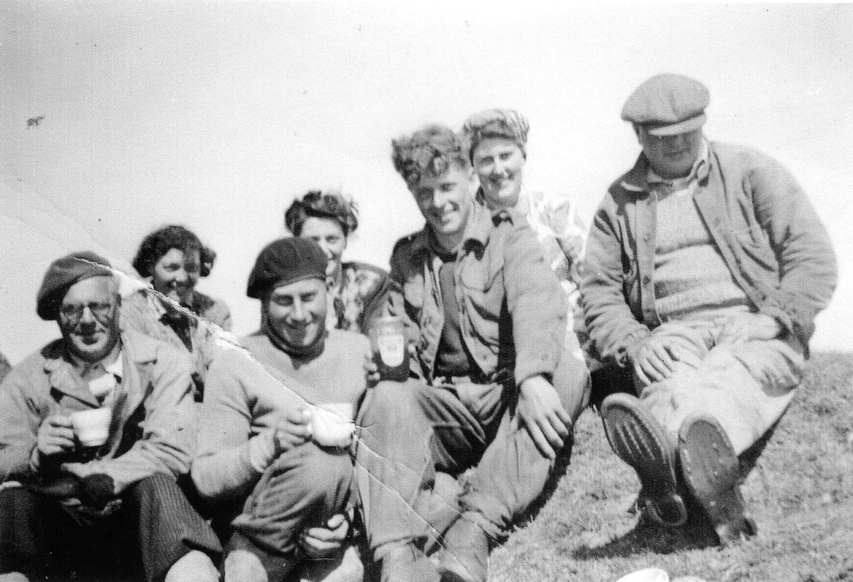
We collected old photographs of Uig and borrowed the villlage archive boxes for the ceilidh so that people could share their memories and put names to faces and places.
Screwtops……………….
A group of peat cutters

Slide 51
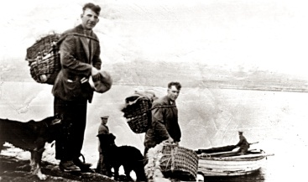
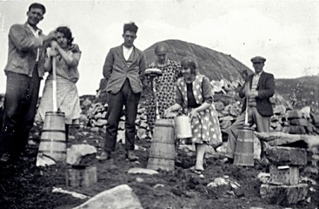
It has been interesting to see how much croft life has changed in a short space of time. When did the boiler suit and wellies replace Harris tweed and stout boots for croft work? The woman below looks very fashionably dressed for churning butter.
Who remembers Oxendales catalogue and the Marshall Ward catalogue and the travelling salesman?
Heading to a Valtos sheiling
Making butter - Airidh an Fhorsa

Slide 52
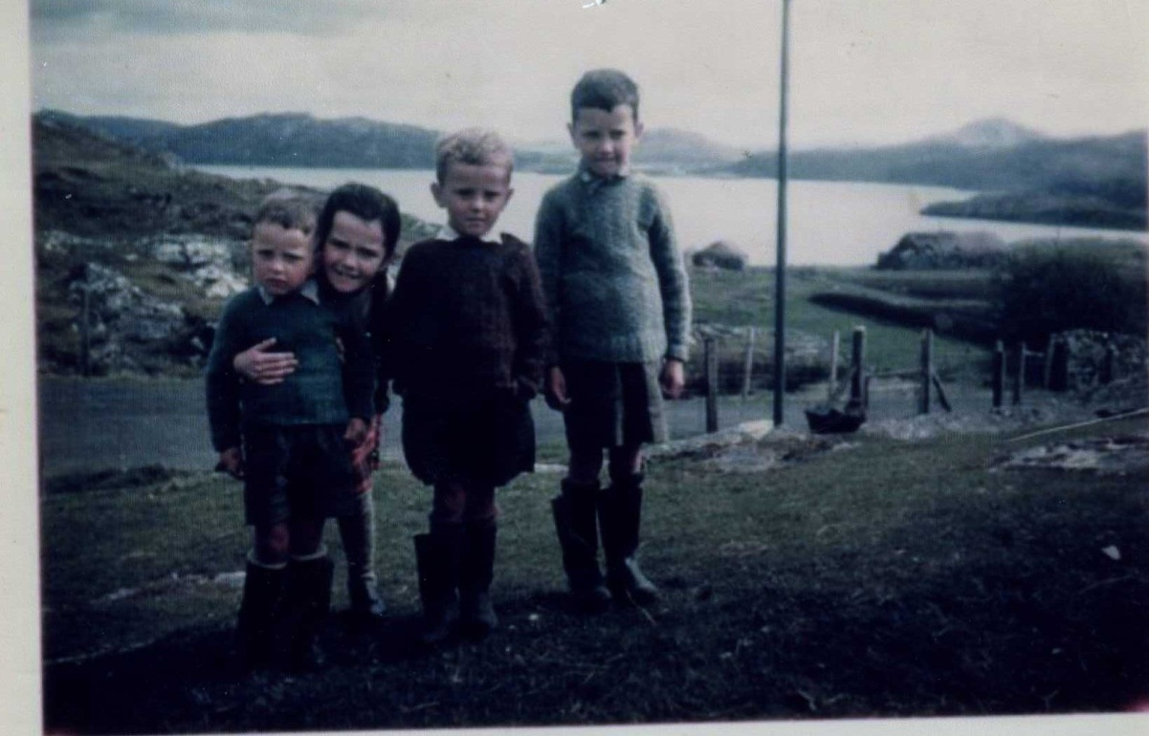
Some visitors to the ceilidh brought some photographs to share. This was taken in 1961 at 11 Reef – Donald George, Margaret, Norman and Iain Chisholm. Note the hand knitted jumpers, the obligatory, oversized welly boots and also the blackhouse at 10 Reef.

Slide 53
COMMUNITY INVOLVEMENT
Hydrogen Dave said that he would make a Time Capsule for us.
The Directors of the Bhaltos Community Trust decided to create a Bhaltos Tweed to promote the project and the area in which we live. This was completed in time for the Dedication Ceremony.
The Dedication Ceremony and an evening ceilidh to coincide with the 100th anniversary of the Reef Raiders and the 15th anniversary of the formation of the Bhaltos Community Trust will be held on Friday 24th May, 2013.

Slide 54

THE TIME CAPSULE
Hydrogen Dave made us a time capsule. It does look a bit like a thermos flask, but once it’s filled and sealed, the contents won’t decay.
What should go into it to give future generations a snapshot of life in Bhaltos over the centuries?

Slide 55

THE BHALTOS TWEED
Creating a Bhaltos Tweed was difficult – selecting colours and a pattern which would portray the landscape and seascape of this community. With Lynne’s help, colours were selected from a textile palette and the design team at Shawbost Mill were tasked with weaving them together. Out of a wealth of possibilities, this was the final choice.

Slide 56

HELPING HANDS FOR THE PREPARATIONS FOR THE CEILIDH
We decided to try to create a Taigh Ceilidh in the community hall – painting a backdrop of stone walls and finding as many bits and pieces which fitted into the theme from the local community.
There were enough volunteers of all ages who gave up a Saturday to paint the backdrops and to make stage props for the ceilidh.
William helped us as part of his service in the community certificate for his Duke of Edinburgh award.

Slide 57


Painting the backdrops – members of the community donated paint, brushes, rollers and trays.

Slide 58


We decided that it would be good to transform the hall into a taigh ceilidh – with stone walls, fireplace and as many bits of old furniture as we could find in the community. Many thanks to everybody who donated the precious China tea sets for our evening supper. Thanks also to the men who transported the furniture to the hall and set it all up.

Slide 59


COMMUNITY HELP TO TRANSFORM THE HALL INTO SOMETHING MORE INFORMAL
Putting the backdrops on to the walls
The bar area.

Slide 60



Thursday afternoon – full steam ahead………
From the folks of the Bhaltos Community, we were able to find enough old bits and pieces to create a traditional Taigh Ceildih atmosphere.

Slide 61


Artistic endeavours!

Slide 62


More artistic endeavours – in the taigh ceilidh and in the tearoom with displays of island life, past and present. The tearoom also had visitors on the Saturday afternoon to research island roots from the museum archives.

Slide 63


The Tearoom was set up with a display which gave information about the work of the Bhaltos Community Trust , about the issues which led to the Land Clearances, the Land Raids and the subsequent land reforms.
There were displays about the lives of our older folks and writing from the children from the school. The archive boxes were also available. These boxes contain photos and family trees from all the villages in Uig.

Slide 64
THE ENTERTAINMENT
As part of the ceilidh, we were keen to showcase local talent and we asked Uig or Lewis people to help us with the ceilidh. Entertainment was provided by:
Dougie Maclean who lives in Reef Farmhouse which was raided all these years ago.
Shona Mackenzie from Cnip who sang Uig songs
Cristin Mackenzie from Valtos who played the pipes
Calum Buchanan who sings as Sea Atlas, is from Valtos
Campbell Scanlan from Mangersta , Uig, is a fiddle player and is composing a tune for An Suileachan’s dedication ceremony as part of his portfolio for fiddle compositions.
Anna Fraser and Friends from Callanish, played ceilidh music
Maggie Smith, actress, who entertained us with a monologue from Herring Girls

Slide 65


Some music from Sea Atlas, who performed at this year’s HebCeltFest and then some background information about the design of An Suileachan from Will. Marian, his wife also spoke about her ideas for the design and how it all came together.

Slide 66

The students of Sabhal Mor Ostaig decided to use An Sùileachan as part of their studies. They came over and filmed and interviewed people who were part of the project.
MacTV covered the Sùileachan story for a documentary and the story has been run in some newspapers.

Slide 67


The evening was very busy with locals and visitors of all ages coming out to talk and sing and dance.

Slide 68


Slide 69




More ceilidh shots

Slide 70






Slide 71

And after the ceilidh, back to work………
Ian had to source, transport, cut and shape most of the stones in the walls, and fit everything together.
The capping stones had to be found separately as the project moved on – no special tools, just craftsmanship, the tools of the trade and a great deal of time and patience.

Slide 72


Once the walls had been completed, Jim and his son erected the archway, a formidable task requiring determination, strength, patience and precision.

Slide 73

And again, the weather was breathtakingly beautiful and warm.

Slide 74


Slide 75

The day the archway was erected, our local eagles honoured us with a special fly past……………. a truly evocative moment.

Slide 76

THE FINAL BITS AND PIECES
Once the walls had been completed and the archway was in place, we could add the final bits and pieces – the seating, the stone circle, the mill stone and the beacon.
Job done!!

Slide 77

Project commenced 10 January, 2012
Project completed 12 January, 2013

Slide 78


Slide 79


Slide 80


Slide 81


Slide 82


Slide 83


Slide 84


Slide 85


Slide 86


Slide 87

AN SUILEACHAN –
BEAUTIFUL BY DAY OR NIGHT…..

Slide 88


Slide 89
….and already An Sùileachan has begun to capture the imagination of photographers………………

Slide 90


Slide 91


Slide 92


Slide 93


Slide 94
An Sùileachan has been completed, but the next project is already being planned.
We live in an area which is rich in archaeology and history.
Working in collaboration with Comann Eachdraidh Uig, the next project will be twofold - to collate the music and the stories from the community and put them onto a website with a downloadable app and also to build pathways and information boards so that visitors will leave here with a greater understanding of the evolution of The Bhaltos Community - its archaeology, history, language and culture.
The website has already been created and can be viewed at www.uigtrail.com.

Slide 95
MORAN TAING GU……………………………
Our funding partners
John, Joni, Anna and Teen Anne who gave freely of their time, knowledge and expertise to develop the project at different stages
Dr Finlay Macleod for naming An Sùileachan
the pupils and staff of Uig Primary School for their artwork and writing
Todag and Tinie who motivated us to be creative with the ceilidh, and everybody who painted the backdrops and helped to set up the ceilidh
everybody who lent us props of all descriptions and the beautiful China tea sets
everybody who baked and served suppers, and washed up afterwards
all our local, talented entertainers
everybody who came to the ceilidh to support the project
particular thanks to those people who took time to help to clear and clean the hall “the morning after the night before” – a mammoth task which proved that a good time was had by all!!
everybody who gave their stories and photographs for the project
Scottish Salmon company for the loan of the boat
Comann Eachdraidh Uig
Uig Community Centre Association for wonderful facilities
Lynne who project managed the creation of the tweed with Shawbost Mill
Hydrogen Dave for his time capsule
Colin, Alistair and Andrew for their photographs
the folks who visited the tearoom over the summer and gave such positive feedback on the exhibition
all those in the community who helped and advised us as the project began to take shape and move forward. – too many to mention
And many, many thanks to Catriona at No7 Reef for endless hospitality -soup, sandwiches , drams, and wise counsel to keep the workforce on track and the spirits from flagging!

